Slide 1
Introduction to
Pathology Informatics
Session 6:
Artificial Intelligence in Pathology
James Harrison, MD PhD
University of Virginia
2025
API distribution, version 1.0.2
Notes:
These 10 slide sets and term lists are being provided through the Association for Pathology Informatics (API) with a license that allows free use, modification, and redistribution with attribution (see the permitted uses slide at the end of each presentation). The design has been kept relatively basic to make editing and adaptation easier. Users are encouraged to modify and improve the slides, share the changes (with attribution of the original material), and possibly contribute the improved slide sets back to the API or other distributors. As designed, the slides are relatively wordy so that they are easier to follow without an instructor’s guide (though one may appear in the future). Feel free to edit the slides to streamline them and optimize them for local teaching style and available time. Some sessions contain optional slides with extra detail, and these are indicated in the slide notes. Some sessions contain slide builds (most are simple) that don’t print well; these sessions have optional slides for printing, and these are indicated in the slide notes.
The goal of these slide sets is to provide foundational information that will allow pathology trainees to more effectively learn and practice pathology, not to teach the performance of specific tasks in pathology. The overall learning objectives are listed on the third slide of session 0 with some explanatory comments in the notes. Subsequent sessions have agendas but not separate learning objectives because the learning objectives remain the same.
The slides have been used with a teaching schedule in which the orientation is given during the summer and then the remaining sessions are give once a month (with lunch) from September to May. They could also fit into a 2, 4, or 5-6 week teaching module if taught on a weekly/semiweekly basis.

Slide 2

Artificial intelligence agenda
AI and machine learning introduction and definitions
Machine learning algorithms, models, and training: How it works
ML performance measurement: generalizability, bias, stability
Best practices for performance verification of machine learning systems
Framework for machine learning implementation
Agenda icon created by Freepik – Flaticon
Notes:
Note: This slide set is conceptually dense and takes about an hour and 15 min to present. If desired, it can be simplified by paring down the detail in some slides or removing slides as appropriate. It’s also possible to split the session in two. If that approach is used, consider ending the first session on slide 27 and starting the second session on the same slide. The first session would address the basics of machine learning and training models (the first two bullets on this slide), and the second session would address performance evaluation starting with generalizability (the last three bullets). Any extra time in the sessions could be used in discussion.
Because of the builds and animations, the slides as presented don’t lend themselves to printing for a handout. To print a handout, hide slides 7-9, 11-12, 24-26, and 28-31, and show slide 13, as indicated in the notes to those slides. To set up for a presentation, show all slides except for slide 13.

Slide 3
Why should clinicians learn about AI?
(Besides all the hype and fear)
“AI will soon become ubiquitous in health care…over time, it is likely that every medical specialty will be influenced by AI, and some will be transformed.”
“It is imperative that clinicians have the knowledge and skills to assess and determine the appropriate application of AI outputs, for their own clinical practice and for their patients.”
“…a process analogous to the CLIA certification for laboratory studies could help ensure that not only are the criteria for adoption and implementation of algorithms rigorous but also that ongoing assessments of their applicability and accuracy occur.”
James CA, Wachter RM, Woolliscroft JO. Preparing clinicians for a clinical world influenced by artificial intelligence. JAMA. Published online March 21, 2022. doi:10.1001/jama.2022.3580

Slide 4
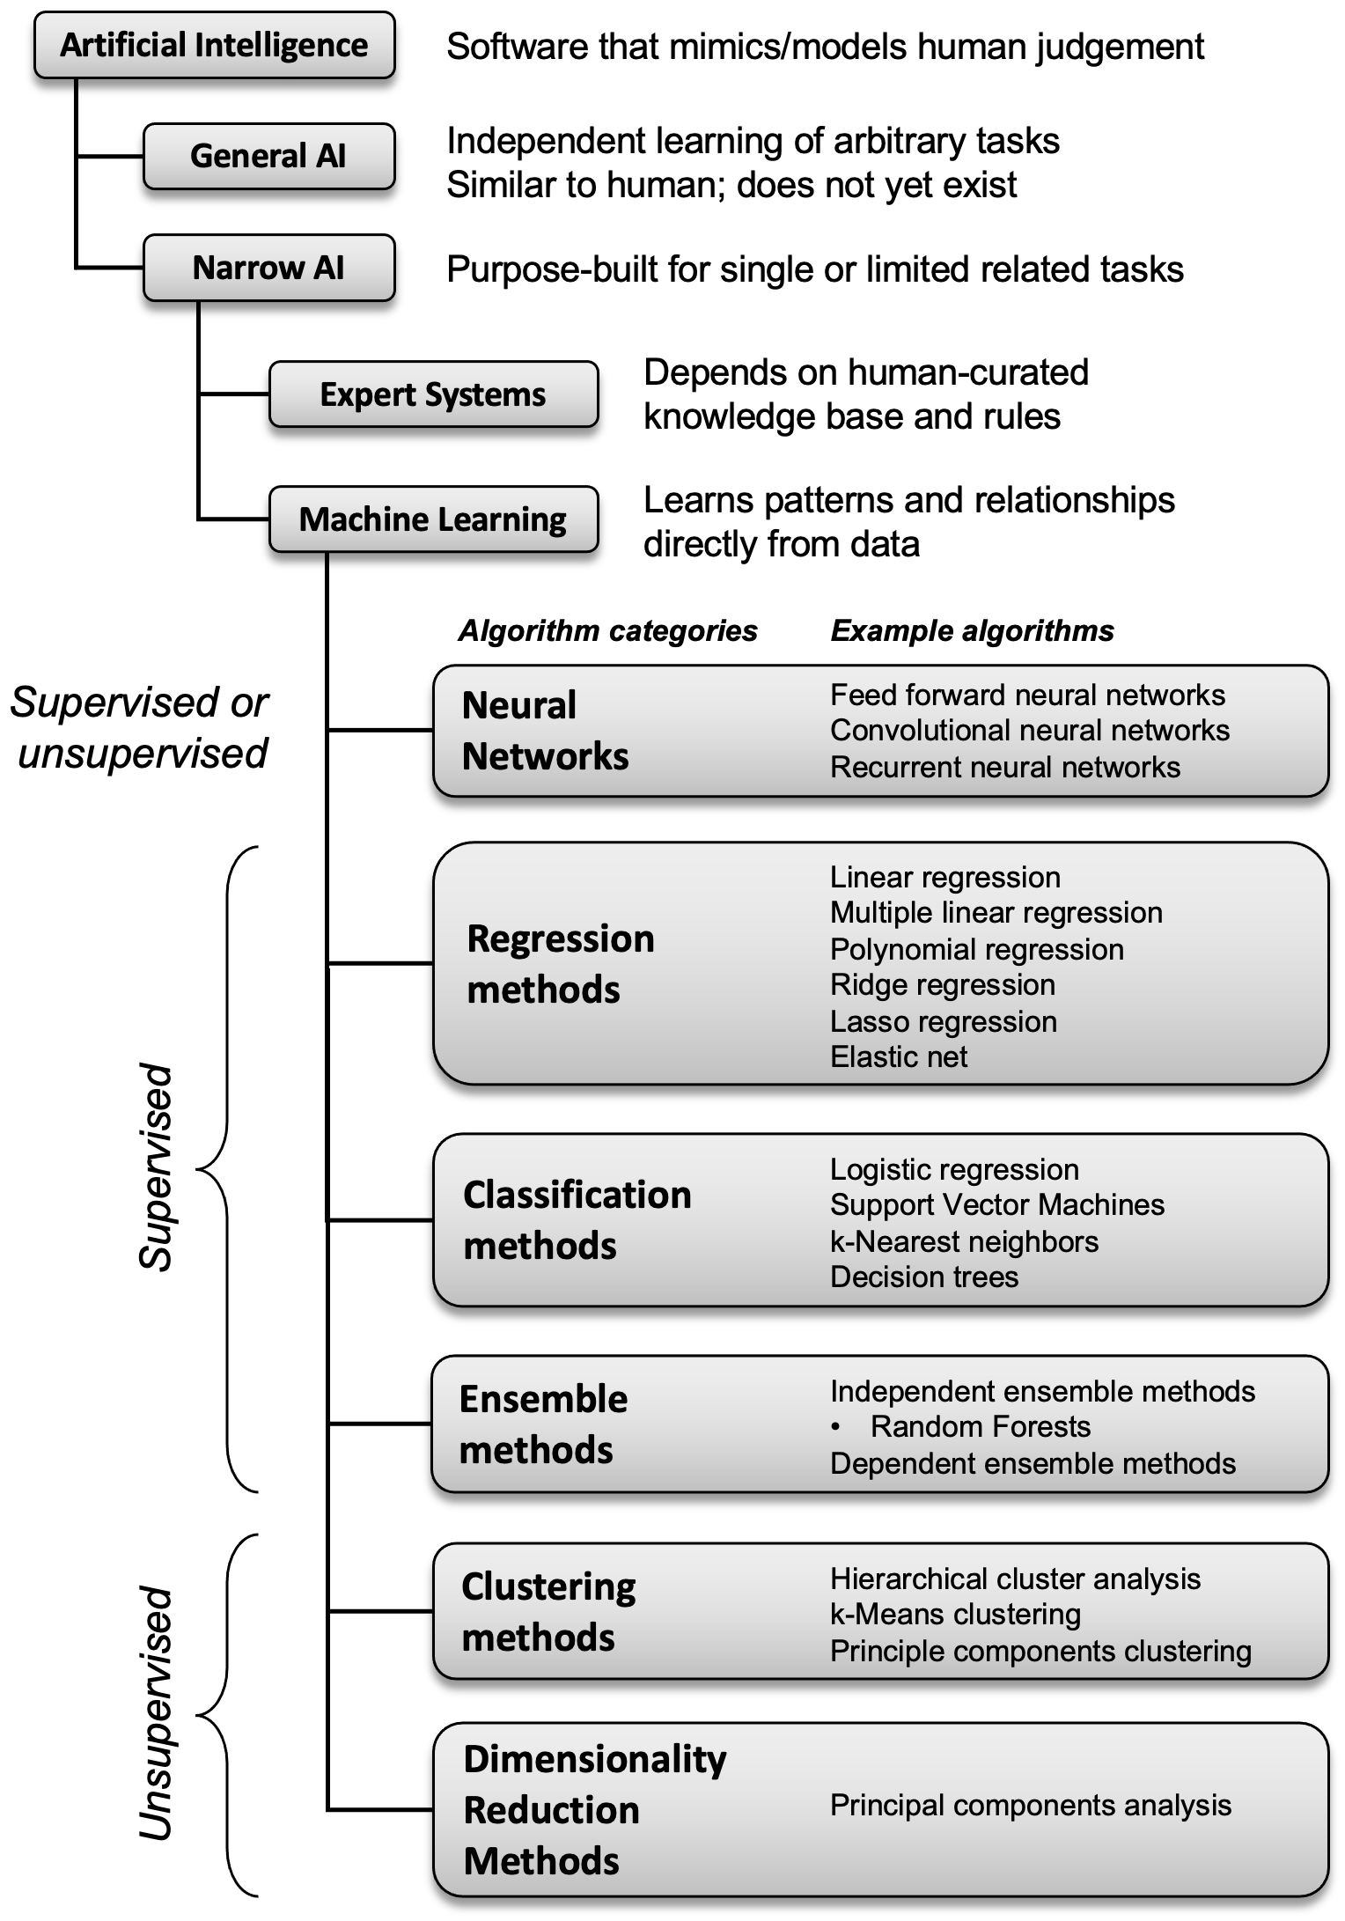
What is AI?
Computer simulation of
intelligent (human) behavior
Machine learning
Algorithms, types of AI programs
Supervised, trained on correct answers
Unsupervised, groups similar data
Regression yields numbers as answer
Classification yields choices as answer
  Binary (positive/negative)
  Multi-class
Adapted from Harrison JH, et al. Introduction to artificial intelligence and machine learning for pathology. Arch Pathol Lab Med. 2021;145(10):1228-1254. doi:10.5858/arpa.2020-0541-cp
Notes:
Narrow AI includes rules-based expert systems that use pre-defined knowledge bases, which have been used in a limited way in healthcare for many years, and machine learning, in which software learns patterns directly from the data. ML is the approach that’s stimulating the current excitement about AI.

Slide 5
What is a good machine learning problem?
Repetitive decision-making (cases)
Each decision is based on the same kinds of data (case features)
There are many features per case
Features and decision outcome can be expressed numerically
Relationships between the features are not well-defined
Decision is based on judgement rather than well-established rules
Lots of example cases are available with correct decisions
Healthcare examples
  Image interpretation (ophthalmology, radiology, pathology, dermatology)
  Clinical course/prognosis prediction (sepsis risk, length of stay, readmission)

Slide 6
Expectations for machine learning in AP
Prerequisite: Whole Slide Imaging pipeline in place
Automation of tasks previously requiring human judgement
  Case triage and workflow, organizing slides
  Finding & counting objects (TILs, mitoses,
  organisms, mets, margin involvement, invasion)
  Finding and marking regions of interest on a slide
  Calculating areas (% tumor or necrosis)
  Grading tumors and marking high grade areas
  Second look systems?
  Differential dx? Dx probability? Independent dx?
Augmented
Intelligence
Notes:
People are excited about AI because it may be able to automate SOME tasks that previously were very difficult for computers…
Expected to be less work than developing expert systems for the same tasks.
Anticipated large market.

Slide 7
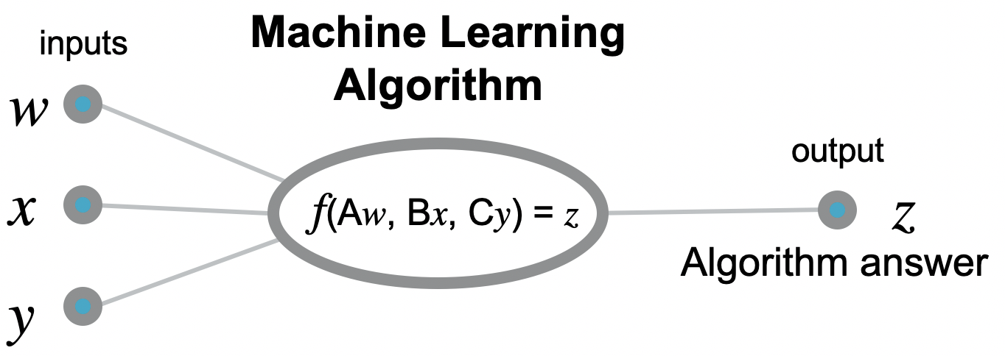
What is supervised learning?
Computers “learn” how to complete a specific task or make a decision based on patterns in example data that include correct answers
Case
Feature 1
Feature 2
Feature 3
…
You can think of an AI algorithm as an equation that has constants representing weights and cutoffs, and terms representing the input data. The constants and input data are used to calculate an answer.
Adapted from Harrison JH, et al. Introduction to artificial intelligence and machine learning for pathology. Arch Pathol Lab Med. 2021;145(10):1228-1254. doi:10.5858/arpa.2020-0541-cp
Notes:
Supervised learning is expected to be important in pathology, so we’ll concentrate on that for this discussion.
There are many forms of machine learning algorithms, but for our discussion we can think of them as analogous to equations where the input data are variables, and there are a set of constants that can be adjusted to modify the output, which might represent a classification or outcome prediction with a probability.

Slide 8
What is supervised learning?
Computers “learn” how to complete a specific task or make a decision based on patterns in example data that include correct answers
Training algorithm
Software framework for training and validation
inputs
Machine Learning
Algorithm
Training data
cleaned
normalized
labeled
w
Training
x
output
f(Aw, Bx, Cy) = z
z
Loss function
y
Algorithm answer
Adapted from Harrison JH, et al. Introduction to artificial intelligence and machine learning for pathology. Arch Pathol Lab Med. 2021;145(10):1228-1254. doi:10.5858/arpa.2020-0541-cp
Notes:
For training the algorithm is embedded in training software that feeds data to the algorithm and tests the output.
The constants are initially randomly set.
Hide for handout

Slide 9
What is supervised learning?
Computers “learn” how to complete a specific task or make a decision based on patterns in example data that include correct answers
Training algorithm
Software framework for training and validation
inputs
Machine Learning
Algorithm
Training data
cleaned
normalized
labeled
w
Training
x
output
f(Aw, Bx, Cy) = z
z
Loss function
y
Algorithm answer
Notes:
The result (probably wrong initially) is received by the loss function…
Hide for handout

Slide 10
What is supervised learning?
Computers “learn” how to complete a specific task or make a decision based on patterns in example data that include correct answers
Training algorithm
Software framework for training and validation
inputs
Machine Learning
Algorithm
Training data
cleaned
normalized
labeled
w
Training
x
output
f(Aw, Bx, Cy) = z
z
Loss function
y
Algorithm answer
label
(correct answer)
Notes:
…and compared to the correct answer.
Hide for handout

Slide 11
What is supervised learning?
Computers “learn” how to complete a specific task or make a decision based on patterns in example data that include correct answers
Training algorithm
Software framework for training and validation
inputs
Machine Learning
Algorithm
modify A, B, C
Training data
cleaned
normalized
labeled
w
Training
x
output
f(Aw, Bx, Cy) = z
z
Loss function
y
Algorithm answer
label
(correct answer)
Initially the constants are set to random values. As the algorithm processes labeled example cases, the distance of the answer from the true label is calculated by the loss function, which then tweaks the constants to make the answer a little more correct.
Notes:
Based on the comparison, the algorithm constants are adjusted slightly to make the answer a bit less wrong. That is repeated thousands of times until answers are mostly right.

Slide 12
What is supervised learning?
Computers “learn” how to complete a specific task or make a decision based on patterns in example data that include correct answers
Training algorithm
Software framework for training and validation
inputs
Machine Learning
Model
Training data
cleaned
normalized
labeled
w
Training
x
output
f(Aw, Bx, Cy) = z
z
Loss function
y
Algorithm answer
Production software tool
Deployment
Operational
data
normalized
Software functions
Notes:
When training is complete, the trained algorithm, called a “model,” is removed from the training environment…
Hide for handout.

Slide 13
What is supervised learning?
Computers “learn” how to complete a specific task or make a decision based on patterns in example data that include correct answers
inputs
Machine Learning
Model
Production software tool
Deployment
Operational
data
normalized
w
x
output
Software functions
f(Aw, Bx, Cy) = z
z
y
Algorithm answer
Notes:
…and deployed as part of useful software to process the input data and produce useful values, classify cases, or make predictions.
Hide for handout

Slide 14
What is supervised learning?
Computers “learn” how to complete a specific task or make a decision based on patterns in example data that include correct answers
Training algorithm
Software framework for training and validation
When training is complete, the trained algorithm, called a “model,” is removed from the training environment and copied into the software where it will perform its function.
inputs
Machine Learning
Model
Training data
cleaned
normalized
labeled
w
Training
x
output
f(Aw, Bx, Cy) = z
z
Loss function
y
Algorithm answer
Machine Learning
Model
Production software tool
inputs
Deployment
Operational
data
normalized
w
x
output
Software functions
f(Aw, Bx, Cy) = z
z
y
Algorithm answer
Notes:
When training is complete, the trained algorithm, called a “model,” is removed from the training environment…
Handout only, hide for presentation

Slide 15
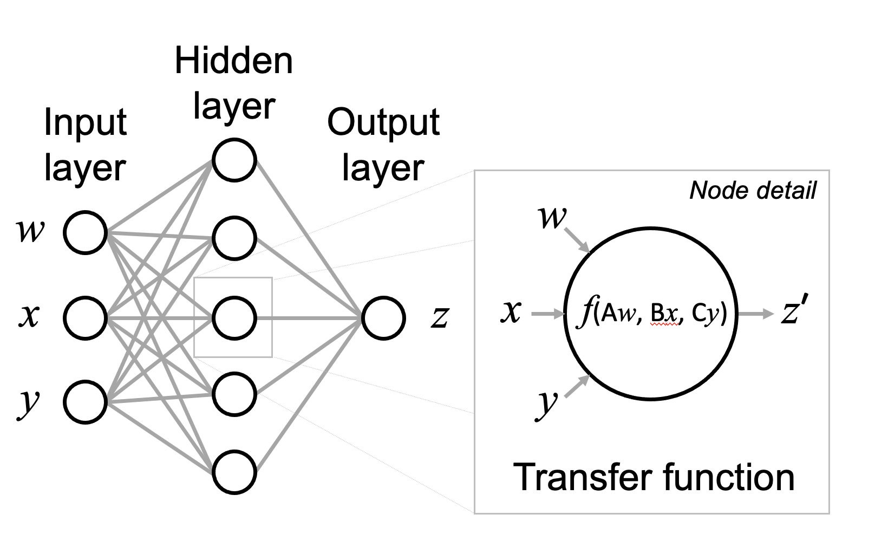
What is a neural network?
Adjustment of constants by backpropagation
Adapted from Harrison JH, et al. Introduction to artificial intelligence and machine learning for pathology. Arch Pathol Lab Med. 2021;145(10):1228-1254. doi:10.5858/arpa.2020-0541-cp

Slide 16
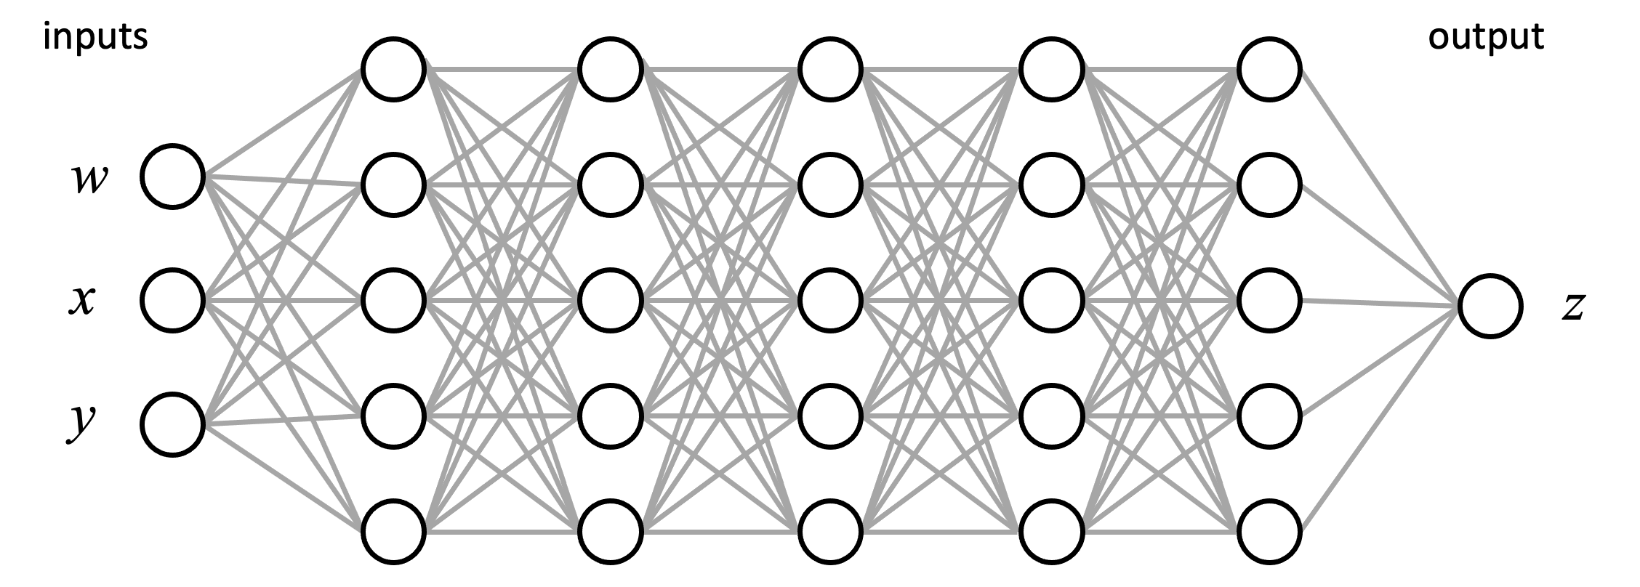
What is a deep neural network?
More than one hidden layer
May be very wide with millions of parameters
This example is a fully-connected, feed-forward NN
Hidden layers
Adapted from Harrison JH, et al. Introduction to artificial intelligence and machine learning for pathology. Arch Pathol Lab Med. 2021;145(10):1228-1254. doi:10.5858/arpa.2020-0541-cp

Slide 17
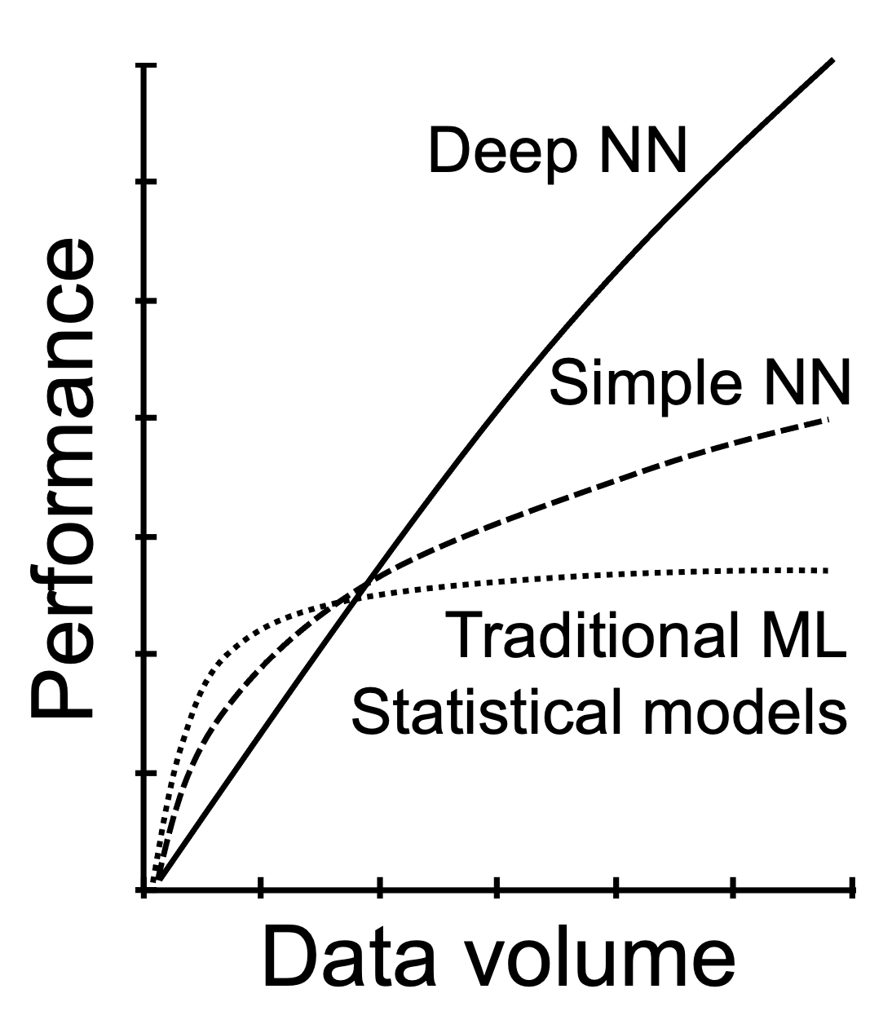
Why is deep learning attracting attention?
Decision-making performance
Can handle thousands of input parameters
But requires large training data sets (thousands of images) and extensive compute resources
Enabled by large image and text databases (ImageNet), high speed computing, and large memory/storage capabilities
Foundation models are large deep NN trained against massive amounts of general data that can be used as starting points for additional specialized training.
Adapted from Harrison JH, et al. Introduction to artificial intelligence and machine learning for pathology. Arch Pathol Lab Med. 2021;145(10):1228-1254. doi:10.5858/arpa.2020-0541-cp
Notes:
Traditional ML models remain useful for smaller data sets with fewer features and may perform better than large NN in those settings.

Slide 18
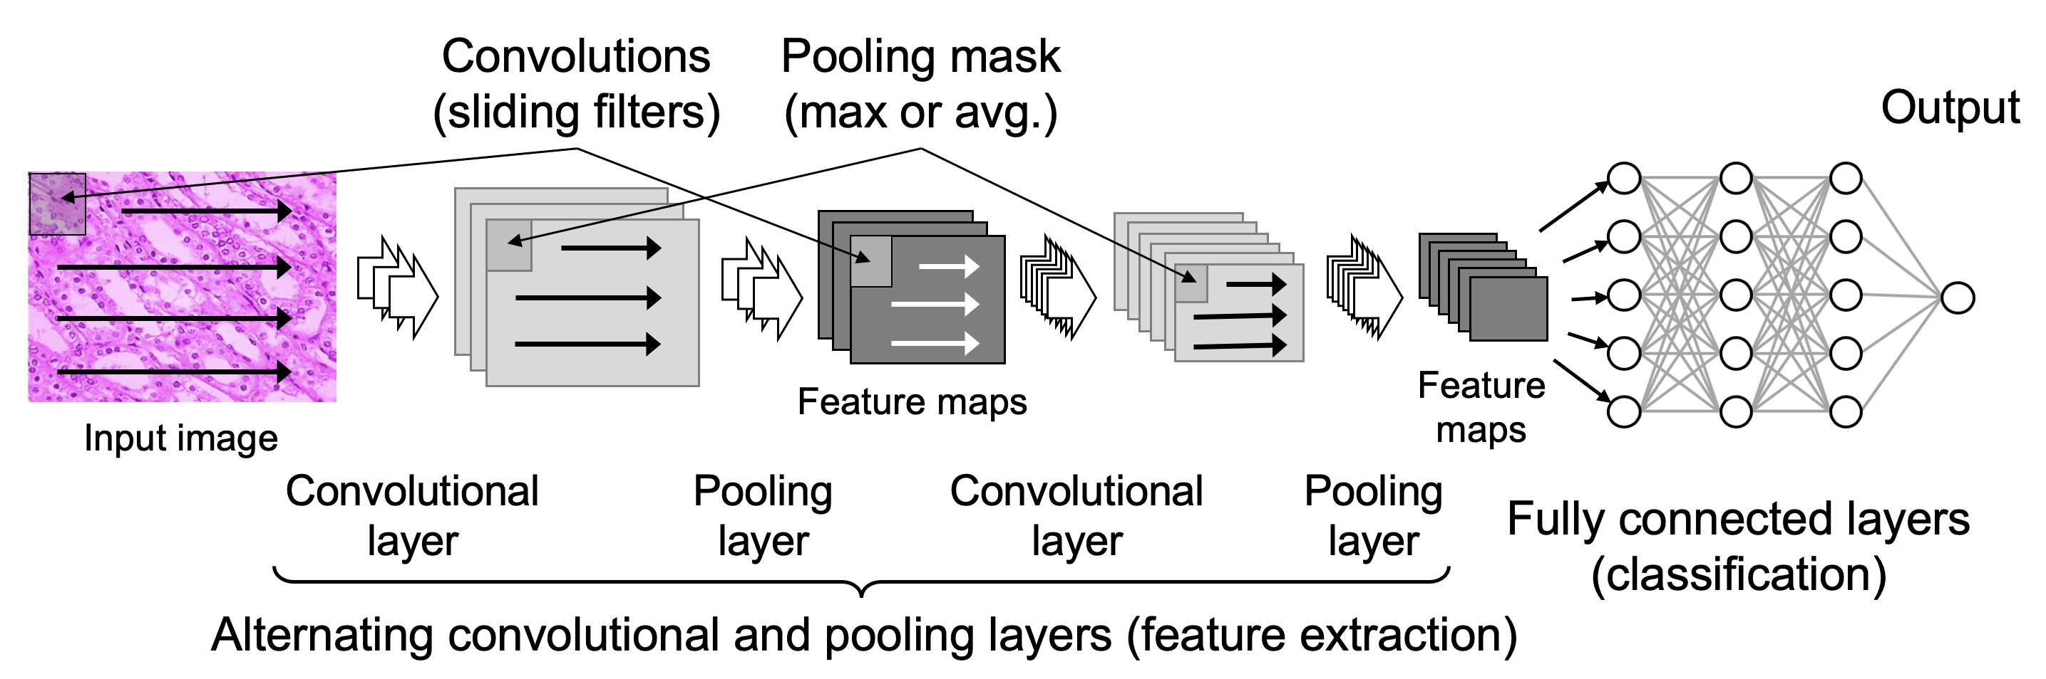
What is a convolutional neural network?
Initial layers for image feature identification and encoding, then deep neural net for classification
Adapted from Harrison JH, et al. Introduction to artificial intelligence and machine learning for pathology. Arch Pathol Lab Med. 2021;145(10):1228-1254. doi:10.5858/arpa.2020-0541-cp

Slide 19

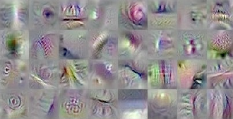
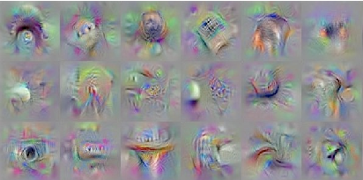
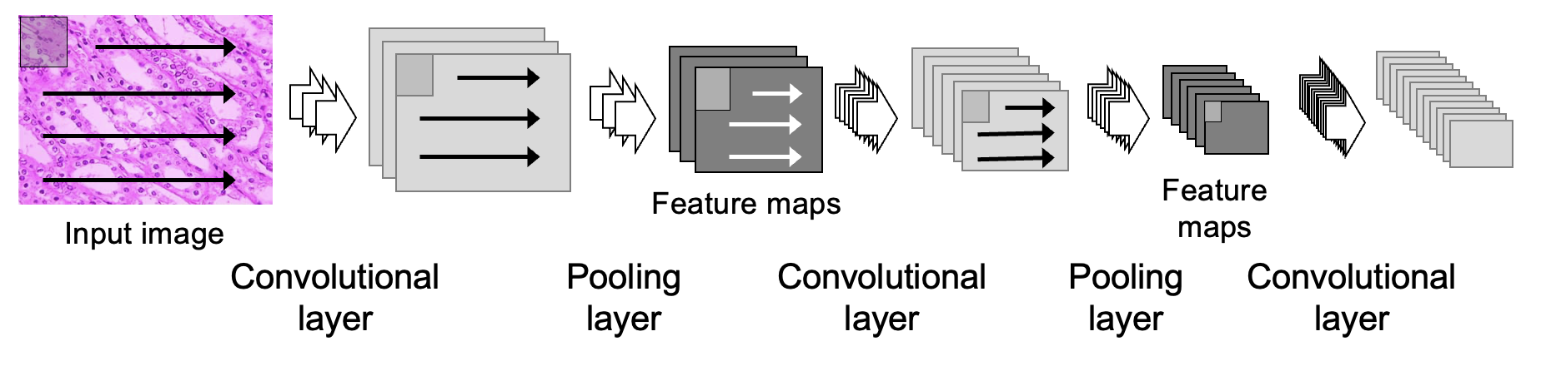
A closer look at convolutions
Convolutional layers recognize progressively more complex image features
These features may or may not correspond to real world objects
Layer 1
Layer 2
Layer 3
Adapted from Harrison JH, et al. Arch Pathol Lab Med. 2021;145(10):1228-1254. doi:10.5858/arpa.2020-0541-cp and Yosinski J, Clune J, Nguyen A, Fuchs T, Lipson H. Understanding neural networks through deep visualization. Published online June 22, 2015. http://arxiv.org/abs/1506.06579

Slide 20
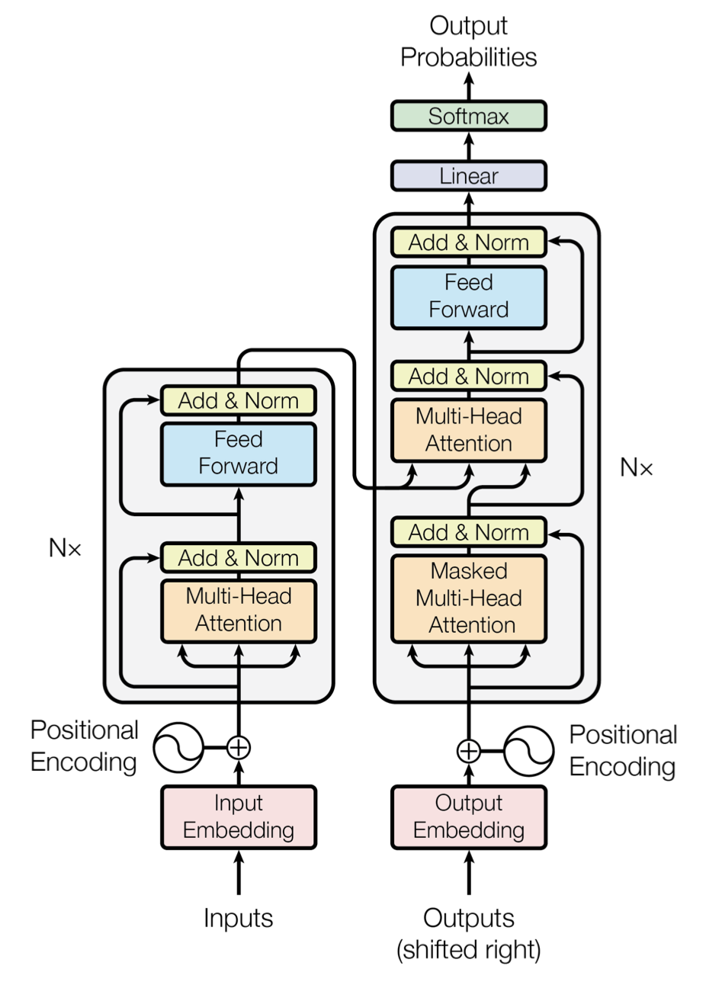
What is generative AI?
Text generation (Large Language Models, LLMs; GPT, Claude, BERT, Llama)
  Large deep NN running on clusters of computers; text construction from word sequence probabilities and prompt context; “self-supervision”
  Knowledge search (question answering), rapid report/letter generation with data integration, summarization, decision support
  Reasonably convincing text but potential for inaccuracy¹
  Reduction in performance over time (drift)² and “hallucination;”
  validation and monitoring required
Image generation (DALL-E, Midjourney, Imagen), multimodal
  Sets of deep neural networks, text and/or image input
  Histology for education, image normalization,³ digital staining?
cycle
LLM transformer architecture
Vaswani A, et al. Attention is all you need.
Published online 2017.
doi:10.48550/ARXIV.1706.03762
Cited > 170,000 times
Ullah E, Parwani A, Baig MM, Singh R. Challenges and barriers of using large language models (LLM) such as ChatGPT for diagnostic medicine with a focus on digital pathology – a recent scoping review. Diagn Pathol. 2024;19(1):43. doi:10.1186/s13000-024-01464-7
Chen L, Zaharia M, Zou J. How is ChatGPT’s behavior changing over time? ArXiv August 1, 2023; accessed August 21, 2023. http://arxiv.org/abs/2307.09009
Shin SJ, You SC, Jeon H, et al. Style transfer strategy for developing a generalizable deep learning application in digital pathology. Comput Methods Programs Biomed. 2021;198:105815. doi:10.1016/j.cmpb.2020.105815
Notes:
Millions or billions of parameters, multiple neural networks running in sequence and parallel (transformer architecture with attention mechanisms)
Multi-head attention layers somewhat analogous in function with text to convolutional layers with images
Width of token (word) window, the amount of text that can be processed at once, defines ability to assure consistency over a span of text
Very large networks of probability relationships between words and word sequences
Repetitive prediction of the next word based on a general language and response structure, a growing word sequence, and a context provided by the prompt
Self-supervision, correct sequences for word prediction already built into training data (written texts)
General purpose “foundational” models (trained on large general text corpuses or images) with supervised training on a smaller set of domain-specific texts or images
“Hallucination,” creation of plausible-sounding but incorrect output

Slide 21
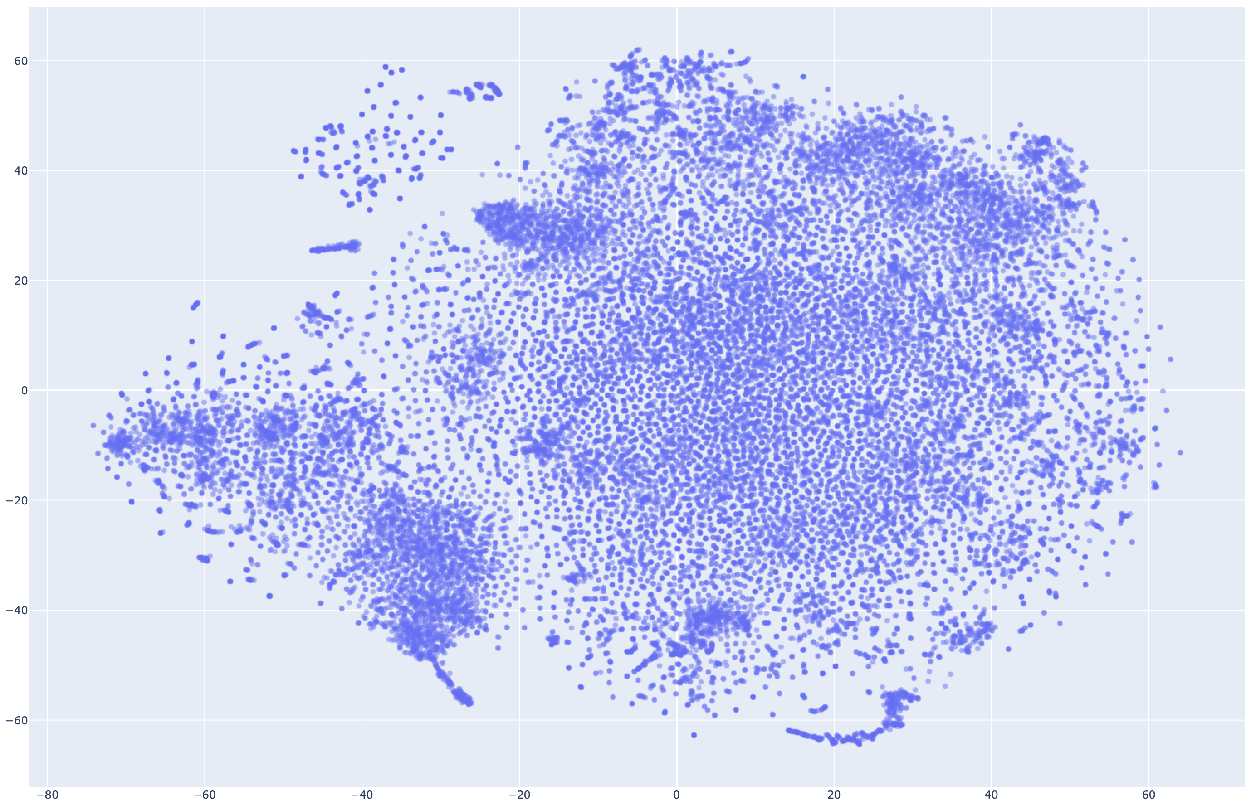
LLMs create and use embedding spaces
Tokens and embedding
  From processing large text libraries
Vector space
BERT example
  30K tokens
  768 dimensions
Current 1000 to 3000 dims
Tokens often used together are close in some dimensions
Hu Y. Visualizing BERT vocab/token embeddings. http://yifanhu.net/BERT/index.html
Notes:
Picture is a TSNE projection of the BERT embedding space. Used with attribution, no copyright specified in original.
Tokens are word fragments, words, or sentence fragments with intrinsic meaning.
Proximity of tokens is used to predict next token based on prompt and content generated so far.

Slide 22
Prompt “engineering” for LLMs
Structured prompt
Persona/role
Instruction
Input data
Context
Examples
Output format
Tone
“Next word” probability machines
  No logic; meaning is coincidental
  “Temperature”
Prompt elements
  Context window
RAG (retrieval-augmented generation)
Zero-shot, one-shot, few-shot
Chain-of-thought
Notes:
Word sequence is based on probability of next word, not logical flow. Any logic in the response is coincidental (based on logic as a property of the embedding space).
Temperature is the random selection of similarly-probable alternatives. Higher temp yields more randomness in the selection (and more varied output)
Context window is the number of tokens (amount of text) that a model can process at one time. GPT-4 was 4K, upped to 8K (about 6000 words). GPT-4o is 128K. Claude is 500K as of the end of 2024.
RAG involves automatic lookup in an authoritative database and insertion of the output into the context of the prompt
Zero-shot, one-shot, and few-shot refers to the number of correct examples provided in the prompt.
Chain of thought is a technique in which the LLM is asked to describe intermediate steps toward a solution. May direct the model down an appropriate path of response to avoid gaps and hallucinations.

Slide 23
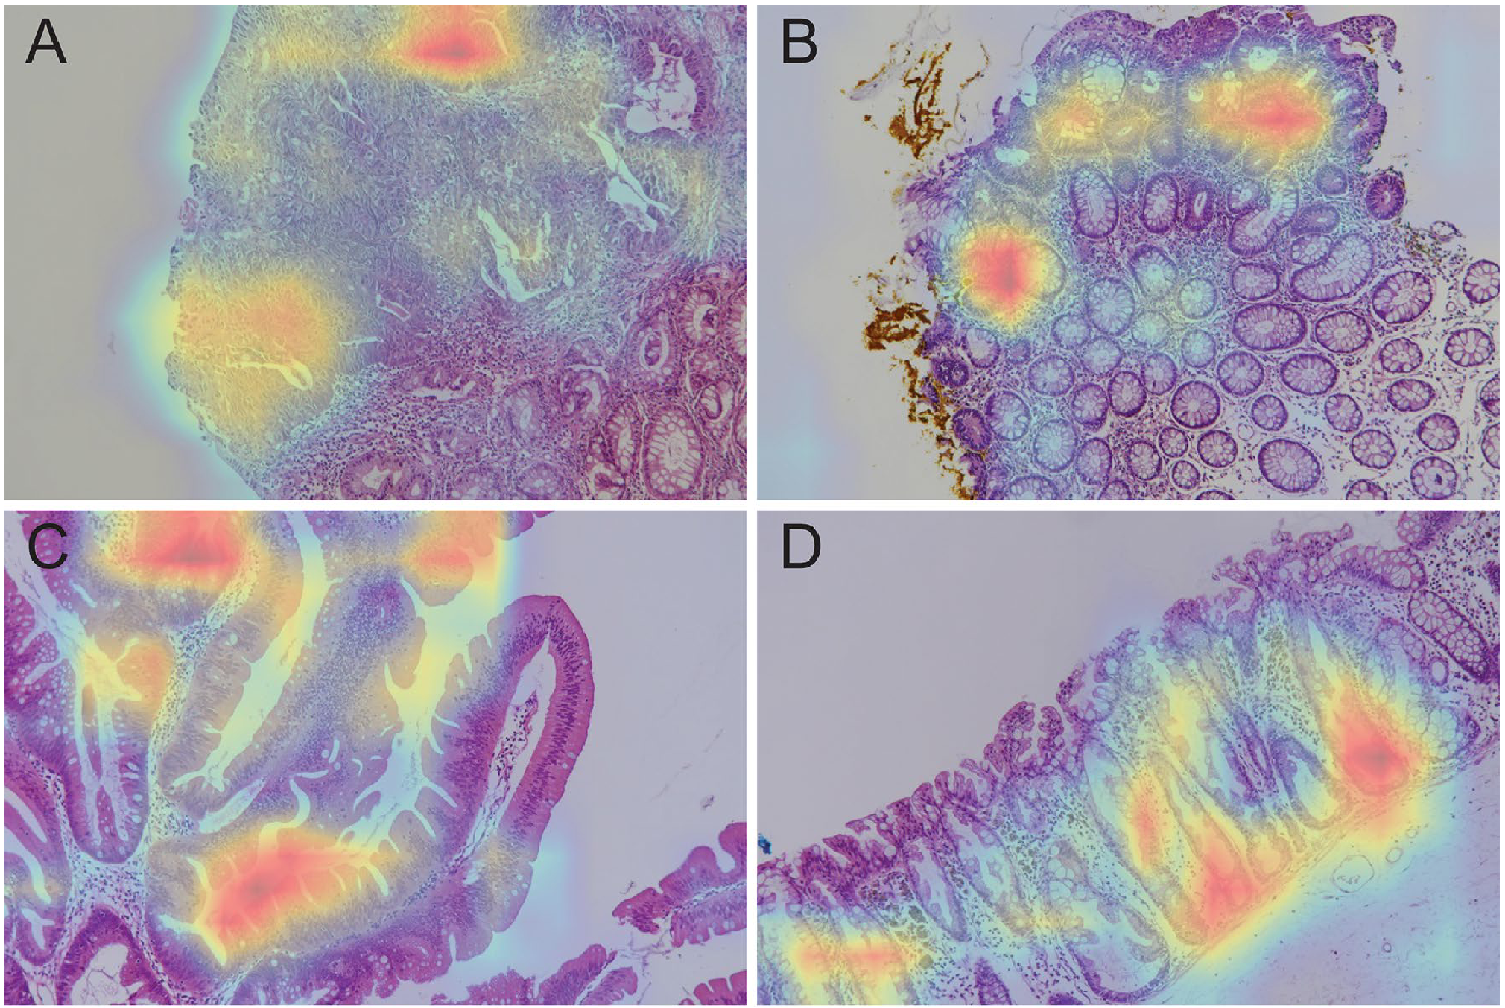
Black box vs. transparency/explainability
Black box: Unraveling how an ML model makes decisions may not be practical
Saliency maps indicate high values from convolutions
Indicate where the AI is looking
Don’t assume understanding of histologic features
A. Adenocarcinoma
B. Tubular adenoma
C. Villous adenoma
D. Sessile villous adenoma
Byeon S-j, Park J, Cho YA, Cho BJ. Automated histological classification for digital pathology images of colonoscopy specimen via deep learning. Sci Rep. 2022;12(1):12804. doi:10.1038/s41598-022-16885-x

Slide 24
Evolving definition of ML “transparency”
The degree to which appropriate information about a device—including its intended use, development, performance, and, when available, logic—is clearly communicated to stakeholders
  Shick AA, Webber CM, Kiarashi N, et al. Transparency of artificial intelligence/machine learning-enabled medical devices. npj Digit Med. 2024;7(1):21. doi:10.1038/s41746-023-00992-8
Stakeholders must be aware when ML is used
Doesn’t require the ability to reproduce output by hand
Notes:
Requires adequate information be available for interpretation and appropriate use of ML output.
Definition developed at an FDA-sponsored conference in 2021.

Slide 25
General concepts in evaluating and using AI
Initial training/testing
Validation and verification
Generalizability
Performance metrics
Bias
Stability/brittleness
Similarity to lab test verification
Framework for AI evaluation and implementation

Slide 26
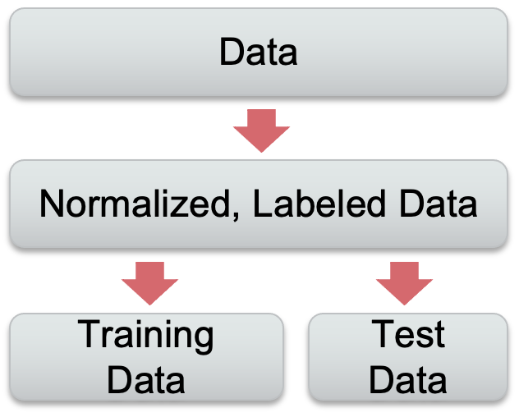
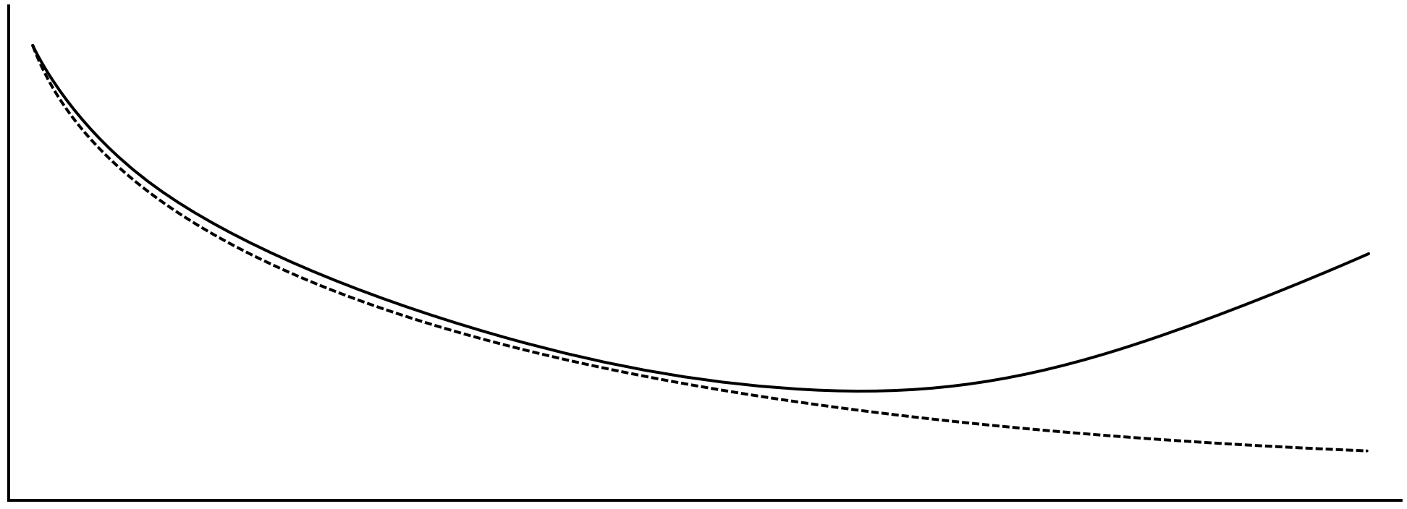
Model performance during training
Similar but separate
test data
Error rate
Training data
Training epoch
Adapted from Harrison JH, et al. Introduction to artificial intelligence and machine learning for pathology. Arch Pathol Lab Med. 2021;145(10):1228-1254. doi:10.5858/arpa.2020-0541-cp
Notes:
Using the chose metric or metrics, models are trained by cycling through the known data (epochs), adjusting the constants and weights in the algorithm to produce better and better performance.
At some point, though, the performance of the model on the separate test data will begin to degrade while the training data performance continues to improve.
Let’s take a look at what’s happening here.

Slide 27
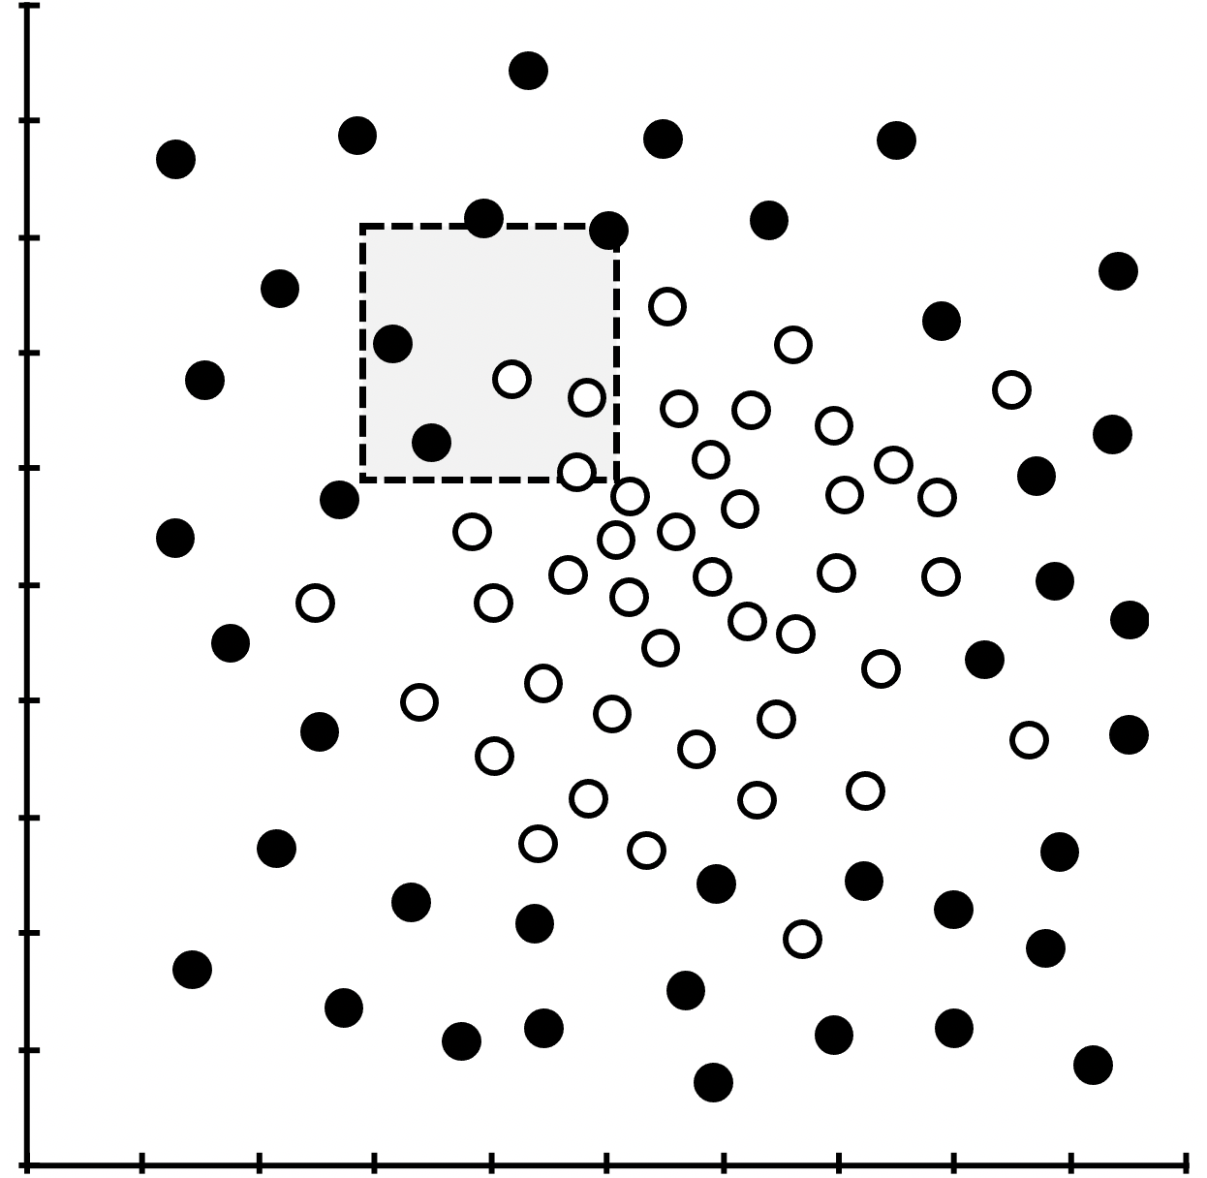
Model performance during training
Error rate
Notes:
When a model is early in training, it’s ability to separate categories of data is poor for both the training data and similar test data.
Here, the separation boundary is poorly targeted and the wrong size and shape.
Hide for handout

Slide 28
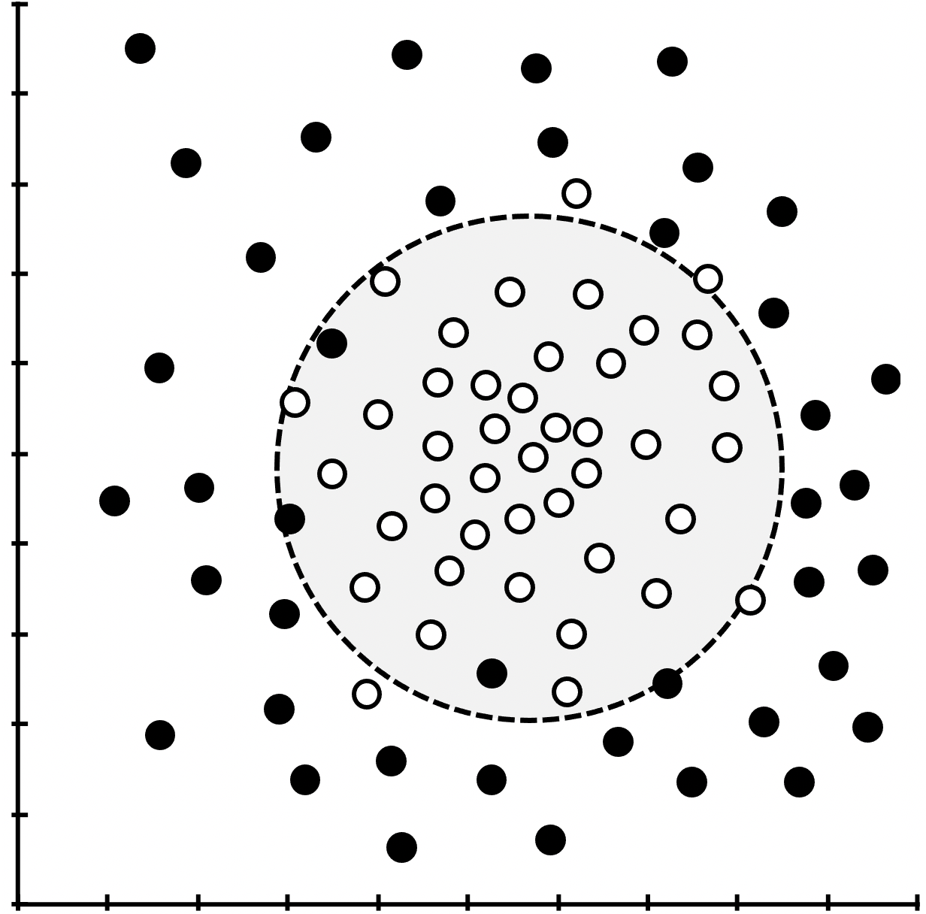
Model performance during training
Error rate
Notes:
With additional training the separation boundary is optimized and discrimination is maximal within the limitations of the model.
Hide for handout

Slide 29
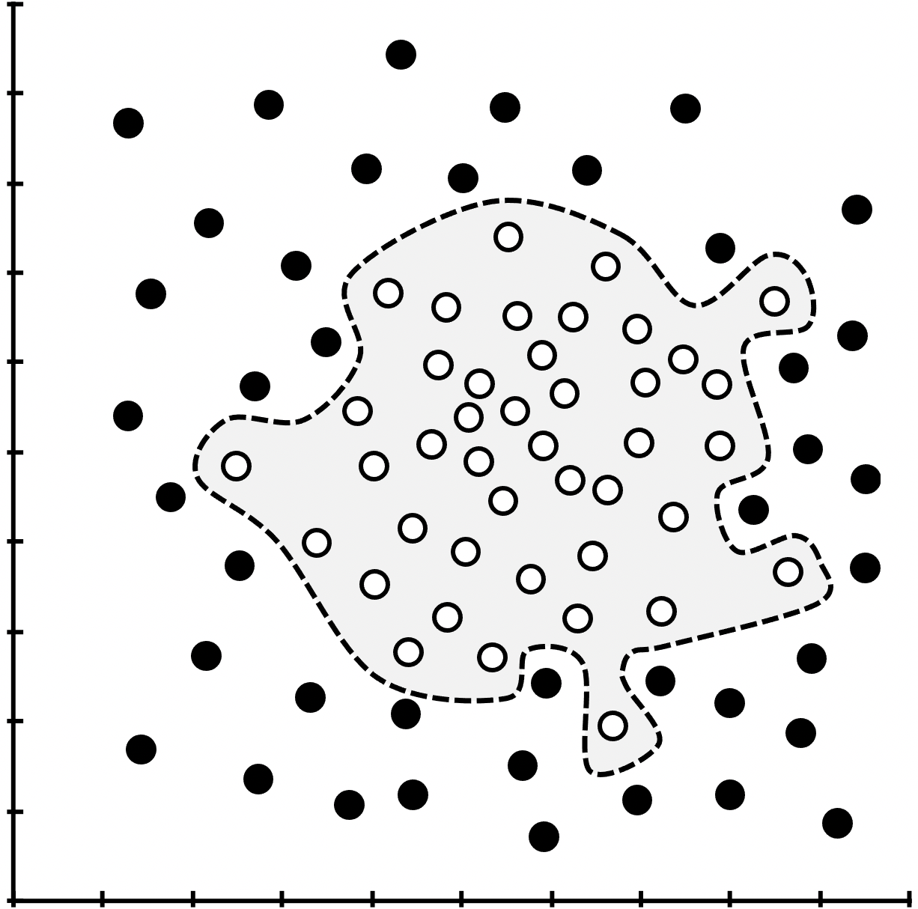
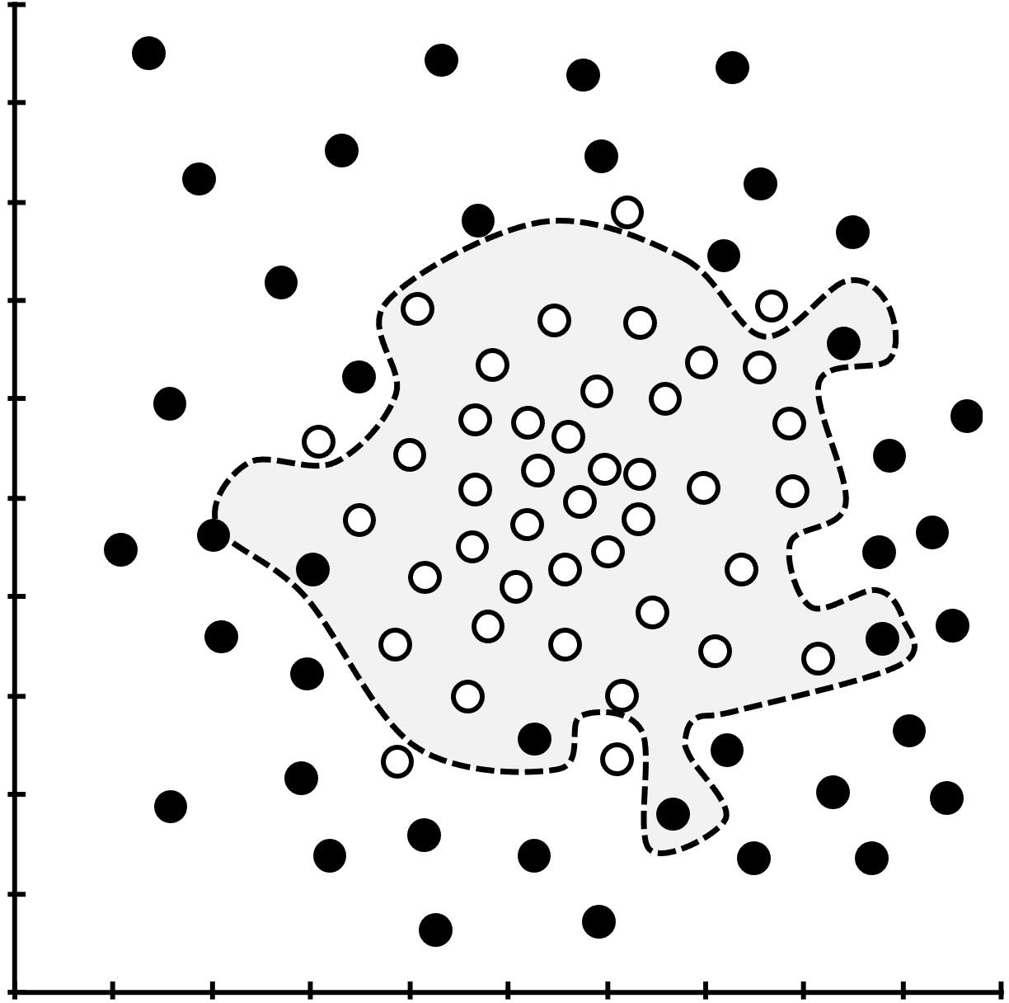
Model performance during training
Error rate
Notes:
With additional training, the separation boundary begins to take on specific characteristics of the training data set Including noise and extraneous data patterns. These work only for that particular data set, but not for similar data in the test set and so general performance on data other that the training set declines.
Hide for handout

Slide 30
Model performance during training
Underfit
Well fit
Overfit
Error rate
Consistently inaccurate
Consistently ~accurate
Inconsistent (high variance)
Adapted from Harrison JH, et al. Introduction to artificial intelligence and machine learning for pathology. Arch Pathol Lab Med. 2021;145(10):1228-1254. doi:10.5858/arpa.2020-0541-cp
Notes:
Models with these characteristics are called under fit, well fit, and over fit.

Slide 31
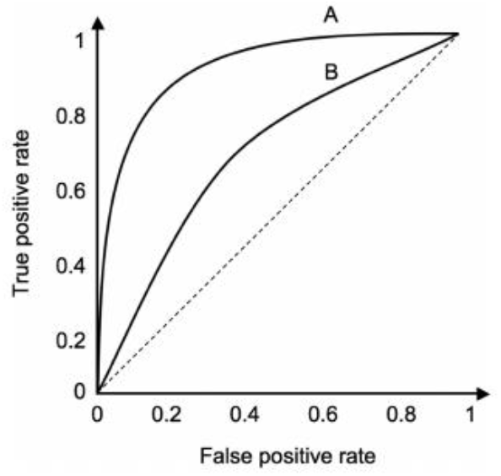
Performance metrics for classifiers
ROC Curve
Accuracy of class assignment: Discrimination
  Generally familiar metrics: sensitivity (recall), specificity, PPV (precision), ROC AUC
  Also F score, PR AUC, FROC, and others
Accuracy of class probability prediction: Calibration
  Measured as overall observed/expected,
  or calibration curve
  Generally familiar concepts analogous to linearity
AI Calibration Curve
observed
expected (predicted)
Notes:
Overall performance metrics. PR AUC: area under the precision-recall curve; FROC: free response operating characteristic, diagnostic sensitivity / false positives per slide
Discrimination measures are analogous to classification based on individual test cutoff values but there are important differences in machine learning bias.
For good calibration, the average outcome of low, medium, and high probability patients should match the average prediction for each group.

Slide 32
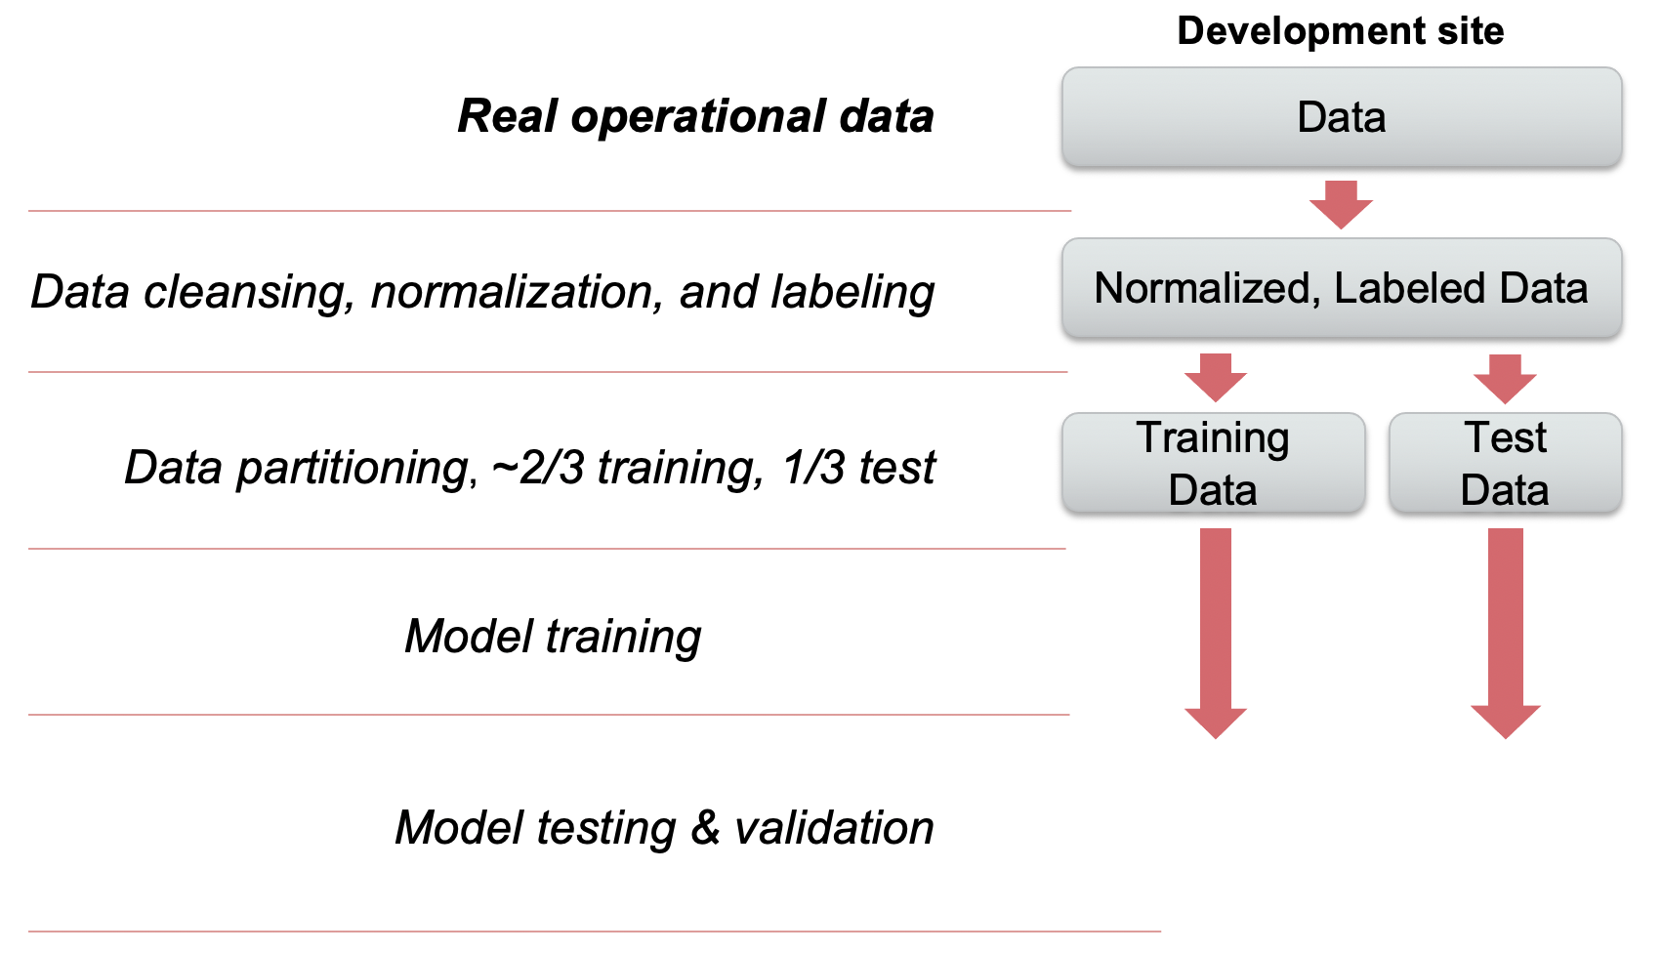
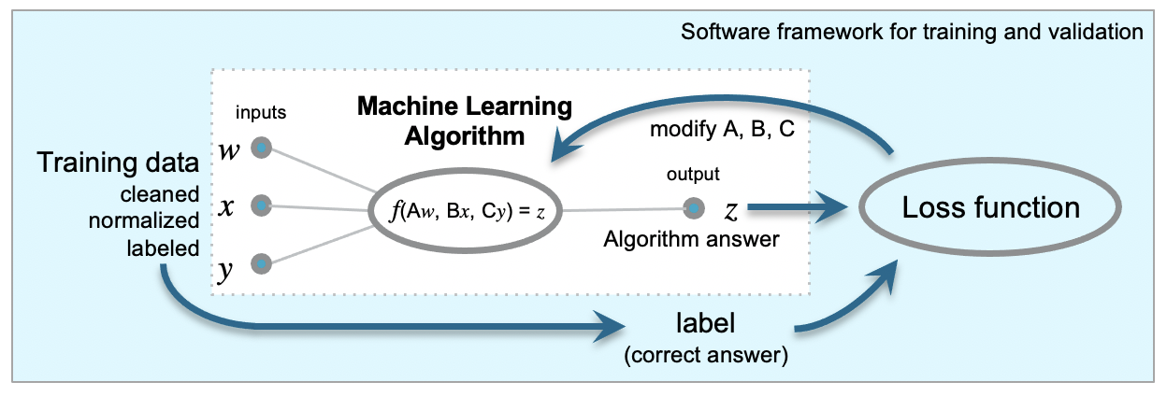
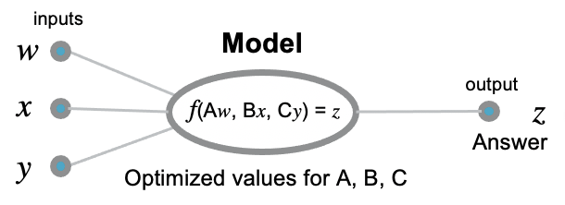
Supervised learning and verification pipeline
Validated model
Notes:
Models are trained as part of an overall process or pipeline starting with operational-quality data, which is cleaned, normalized, and labeled, then split into separate training and test data sets. The model is trained on the training data, and tested and validated against the test data.
The validation that is done at the site where the model is developed is sometimes called “internal validation.”
At that point the model could be deployed for use in the local environment, and its performance can be monitored over time to make sure it’s stable.
If the model will be deployed at another site…
Hide for handout

Slide 33
Supervised learning and verification pipeline
Validated model
Notes:
Training is generally set up as a pipeline starting with operational-quality data, which is cleaned, normalized, and labeled, then split into separate training and test data sets. The model is trained on the training data, and tested and validated against the test data.
The validation that is done at the site where the model is developed is sometimes called “internal validation.”
At that point the model could be deployed for use in the local environment, and its performance can be monitored over time to make sure it’s stable.
If the model will be deployed at another site…
Hide for handout

Slide 34
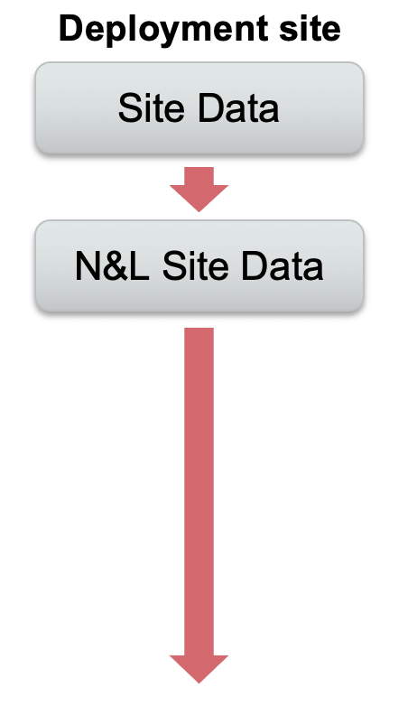

Supervised learning and verification pipeline
Validated model
Remote deployment
Notes:
…running against that sites own data…
Hide for handout

Slide 35

Supervised learning and verification pipeline
Generalizability
Notes:
…there is the possibility that there may be differences between the new site‘s data and the development data that could cause the model to perform differently at the new site.
Hide for handout

Slide 36
Supervised learning and verification pipeline
Generalizability
Site (external) verification
Notes:
Because of that the model needs to be verified at the deployment site using that sites operational data. This is sometimes called “external verification.” Then the performance of the model should be monitored to ensure stability.
External verification will probably be the usual approach with vendor-developed machine learning models, and will likely fall to laboratories when they deploy AI systems.

Slide 37
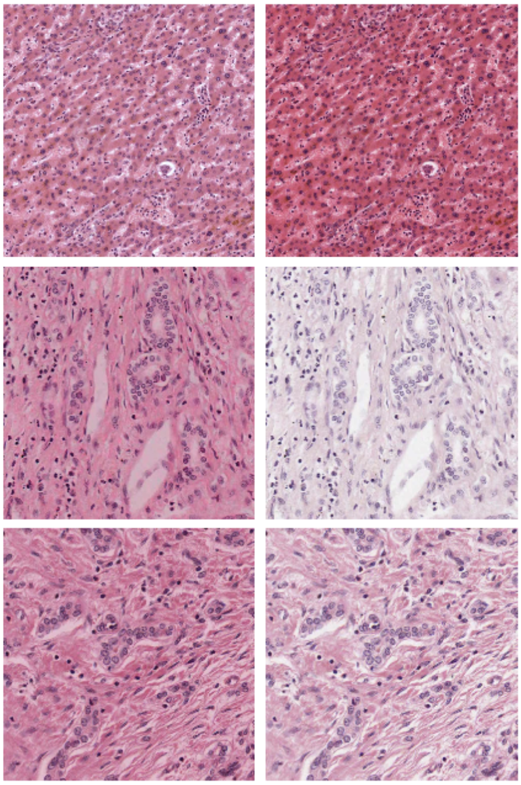
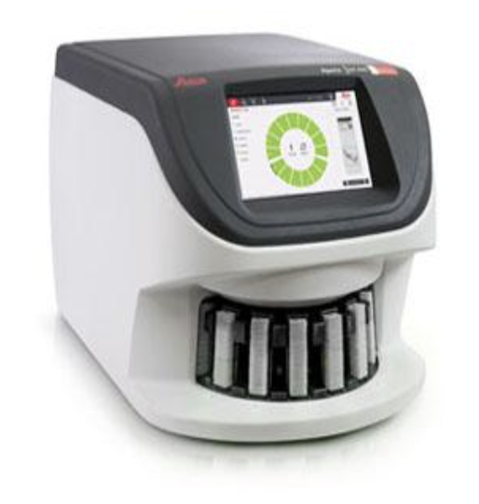
Preanalytical variables in WSI
Tissue acquisition,
transport, & handling
Fixation & processing
Embedding
Sectioning
Staining
Artifacts
Focus & magnification
Resolution
Color calibration
File compression
Leica Biosystems, used with permission
Magee D, Treanor D, Crellin D, et al. Colour Normalisation in Digital Histopathology Images.

Slide 38
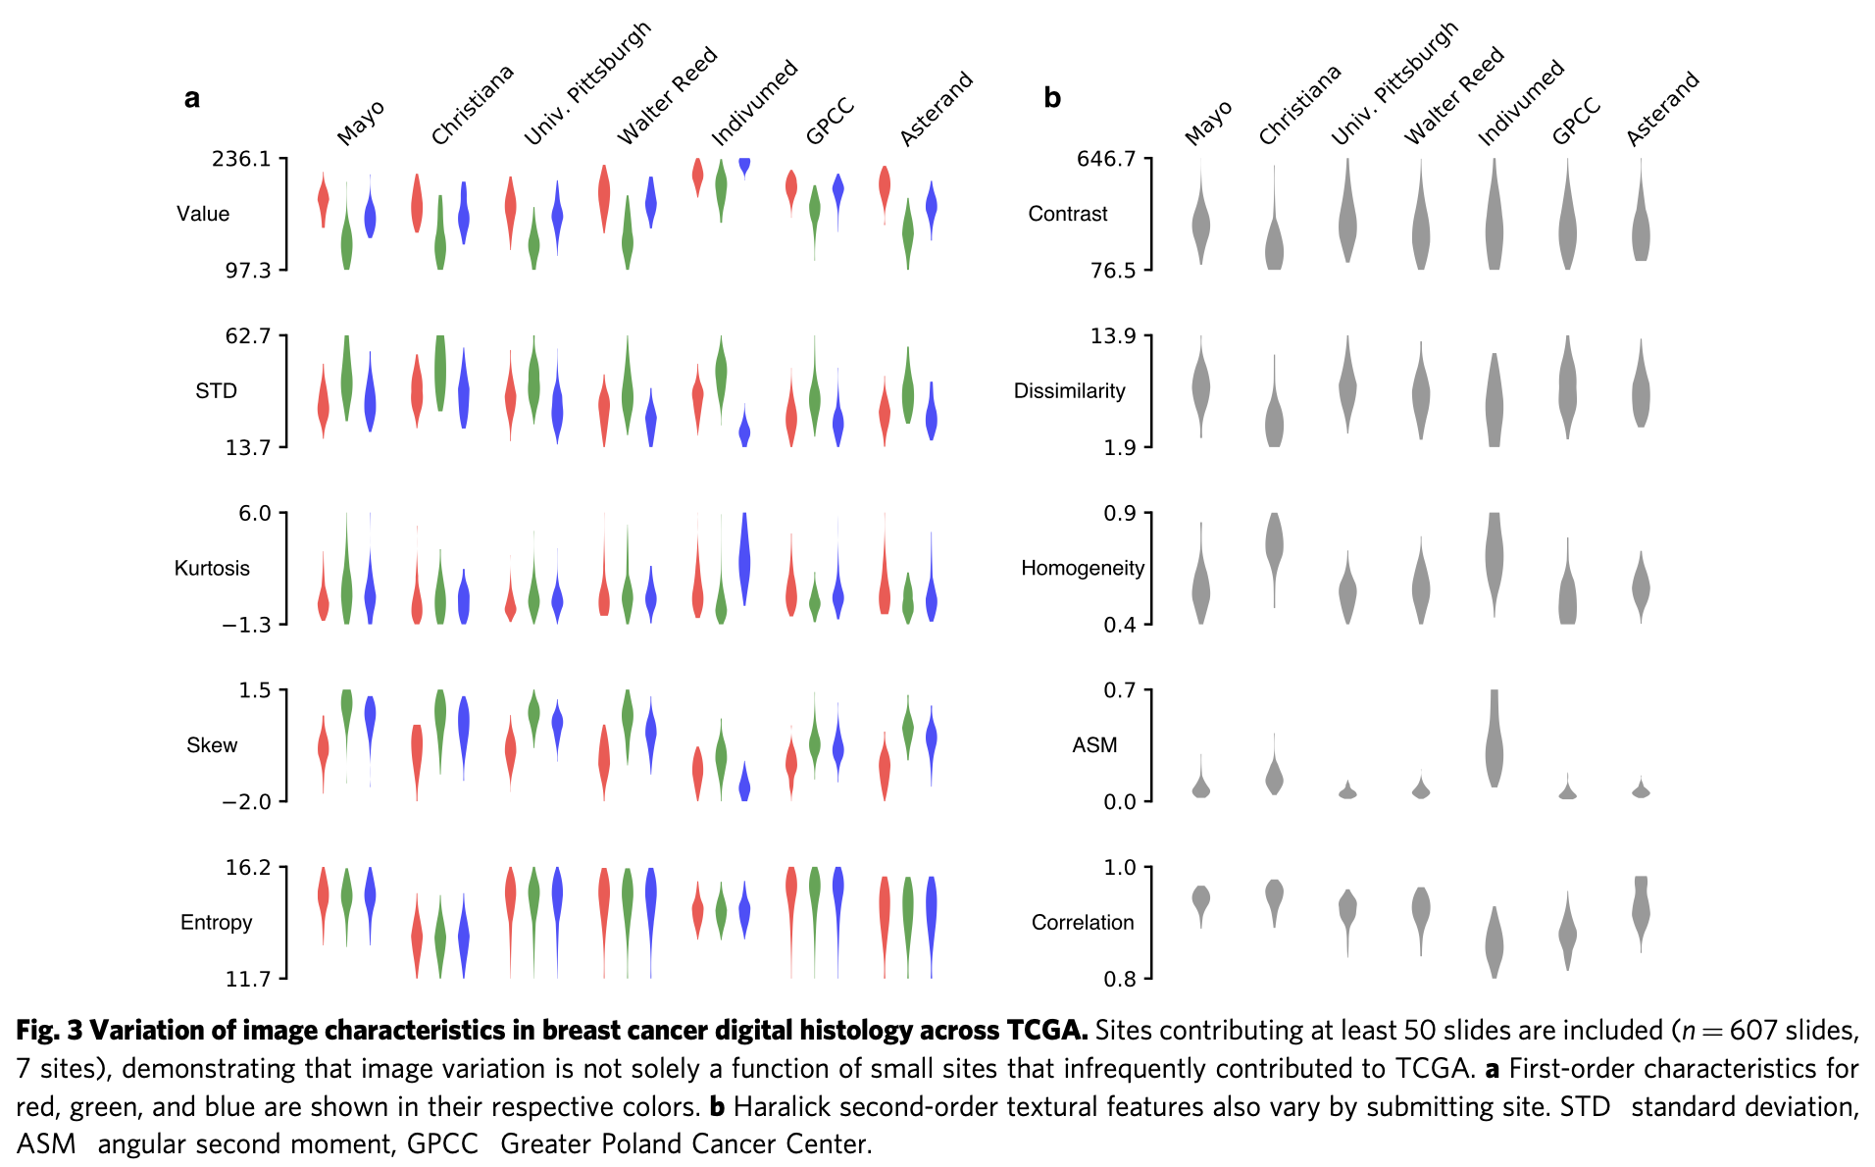
Do pathology images vary among sites?
Howard et al. The impact of site-specific digital histology signatures on deep learning model accuracy and bias. Nat Commun. 2021;12(1):4423. doi:10.1038/s41467-021-24698-1

Slide 39
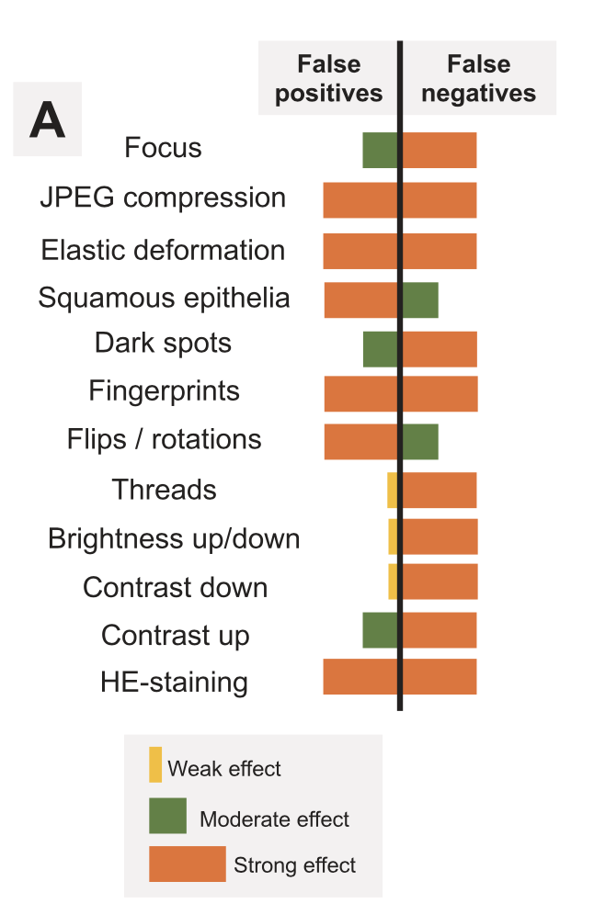
Effect of pathology image artifacts on model performance
Artifacts can be produced during tissue and slide handling, scanning, and data processing
Image artifacts can produce both false negatives and false positives
Artifact type and frequency could contribute to differences in data between sites
Schömig-Markiefka et al. Quality control stress test for deep learning-based diagnostic model in digital pathology. Mod Pathol. Published online 24 2021. doi:10.1038/s41379-021-00859-x
Notes:
For dermatology, the model had performance similar to dermatologists on curated (high quality) benchmark test sets. These are non-curated test sets from clinical operations (teledermatology or clinic photos). Segments are 1) correct across all replicated photos, 2) incorrect across all replicated photos, and 3) inconsistent across replicates.

Slide 40
Generalizability in pathology images
Breast cancer diagnosis model
Trained on local data
Trained on CAMELYON data
Sensitivity
Tested on:
Tested on:
Local data
CAMELYON data
CAMELYON data
Local data
False positive rate
Adapted from Campanella et al. Clinical-grade computational pathology using weakly supervised deep learning on whole slide images. Nature Medicine. Published online 2019. doi:10.1038/s41591-019-0508-1, Extended Data Figure 5

Slide 41
Other classification performance problems
Embedded bias
  Systematic discrimination/calibration error in an apparently well-trained model
Drift/shift (bias developing after deployment)
  Loss of performance over time in a previously accurate system because of changes in data
Brittleness (unpredictable classification failure)

Slide 42
Embedded bias in deployed models
Inherent bias (algorithm design)
  Poor fit between type of model and deployment data/task
  Less common, easier to recognize in model development
Data-derived bias (“trained in”)
  Training data inappropriate for the deployment data/task
  May affect all or only part of the deployment data or population
    Can be more difficult to identify than traditional clinical assay bias
  More likely when data has high dimensionality, high variation, and a potential for unrecognized subgroups
Notes:
Optional, for more information on bias.
Ability to affect only part of a population is different from what we usually think of as bias in a standard test.

Slide 43
Sources of data-derived embedded bias
Labeling bias
  Expert opinion used as the “gold standard” contains error
Historical bias
  Retrospective training data does not reflect future deployment data
Sampling bias
  Training population differs from deployment population
    Non-random selection of training data (selection bias)
    Local variation in relevant subpopulations (site differences in class incidence)
Aggregation bias
  Failure to account for different subpopulations in the data
  Data may have different distribution/meaning/accuracy between subgroups
Evaluation bias
  Differences in the way training and deployment data values are measured

Slide 44
Examples of embedded bias
COMPAS, inaccurate prediction of re-offense in criminal justice
  Historical/sampling bias
Amazon resume screening for tech jobs, gender bias from historical data
  Screened out females even when sex was excluded (cues from other data elements)
  Historical bias
Facial and speech recognition with under-represented cohorts
  Racial disparities in performance
  Twitter account image tool failure to center facial images with dark skin
  Speech-to-text (Apple, MS, Amazon, Google, IBM)*
  Sampling bias
*Koenecke et al. Racial disparities in automated speech recognition. Proc Natl Acad Sci USA. 2020;117(14):7684-7689. doi:10.1073/pnas.1915768117
Notes:
Optional, for more information on bias.

Slide 45
Embedded bias in healthcare
Prediction of health resource needs, based on healthcare data and demographics
  Underprediction of needs of black patients
  Training based on healthcare charges as a proxy for resource needs; underserved populations had lower charges based on lack of access, not lack of need
Sepsis prediction model developed by Epic, reported ROC AUC ~0.8, widely deployed
  Independent site evaluation with ~38,000 hospitalizations: ROC AUC 0.63, missed 67% of patients with sepsis prior to sepsis onset, PPV only 12%
CXR diagnosis by ML is sensitive to sex, poor performance for sex that is not represented
  Effects seen for atelectasis, cardiomegaly, effusion, infiltration, mass, nodule, consolidation, fibrosis, pleural thickening, pneumothorax; many public radiograph data sets don’t include sex information
Skin lesion malignancy prediction from dermatology photos
  Substantially lower performance for data sets with mixed skin tones, correctable with additional training
Obermeyer et al. Dissecting racial bias in an algorithm used to manage the health of populations. Science. 2019;366(6464):447-453. doi:10.1126/science.aax2342
Wong et al. External validation of a widely implemented proprietary sepsis prediction model in hospitalized patients. JAMA Intern Med. Published online June 21, 2021. doi:10.1001/jamainternmed.2021.2626
Larrazabal et al. Gender imbalance in medical imaging datasets produces biased classifiers for computer-aided diagnosis. Proc Natl Acad Sci USA. 2020;117(23):12592-12594. doi:10.1073/pnas.1919012117
Daneshjou et al. Disparities in dermatology AI performance on a diverse, curated clinical image set. Science Advances. 2022;8(32):eabq6147. doi:10.1126/sciadv.abq6147

Slide 46
Biases can develop over time
Data shift
    Discrete change in one or more data elements produces an immediate mismatch between production and original training data
    Sudden reduction in model performance
Data drift
    Incremental changes in system processes produce slowly increasing mismatch between production and original training data
    Progressive decline in model performance
Expected in dynamic settings like healthcare
Notes:
Optional, for more information on shift and drift.
Even if models perform well at installation, they can lose performance over time as data changes. These changes may be in the form of a shift, which is a sudden change such as changing an assay or doing a six sigma project with process changes, or a drift, which is a slow, incremental change in data.
Models that predict probability of, for example, a diagnosis or outcome, can lose calibration such that their probabilities are not correct over part of the probability range. This change may not be apparent in overall discrimination metrics like AU-ROC.

Slide 47
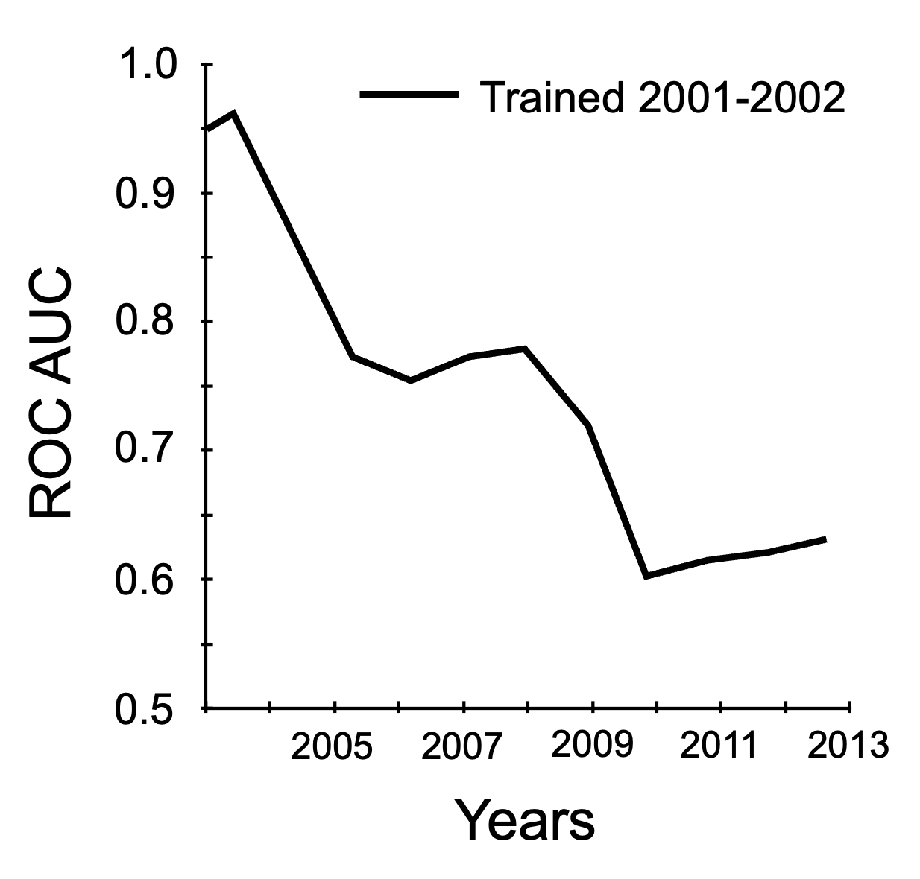
Data drift
Prediction of ICU length of stay using EHR data
  Model trained on one year of data and then used to predict LOS over 10 years
  Performance progressively declined
Healthcare predictive models typically lose performance over time
Adapted from Nestor et al. Feature robustness in non-stationary health records: Caveats to deployable model performance in common clinical machine learning tasks. In: Proceedings of the 4th Machine Learning for Healthcare Conference. Vol 106. Proceedings of Machine Learning Research. PMLR; 2019:381-405. https://proceedings.mlr.press/v106/nestor19a.html

Slide 48
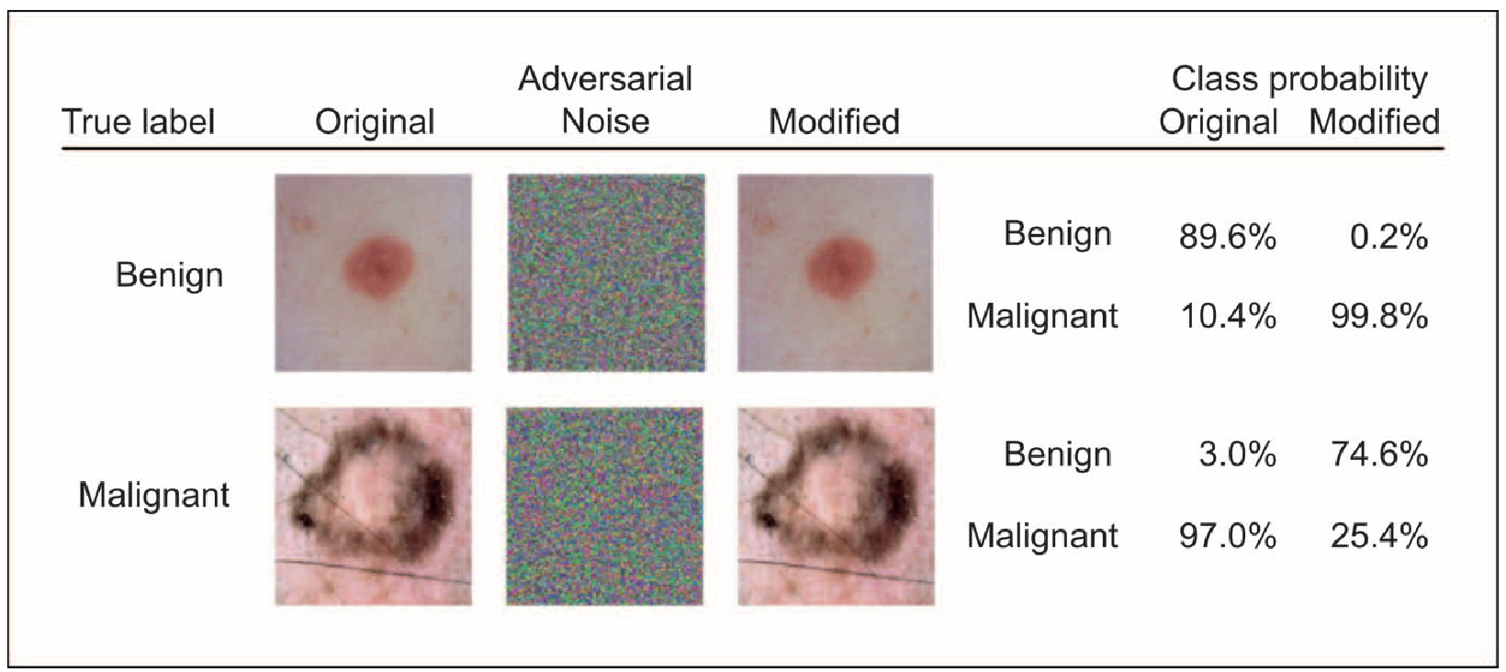
Model performance instability
Slight changes in input can sometimes produce dramatic changes in output
Difficult to predict, can yield discontinuity or “brittleness” in output
Adversarial attacks exploit this; affect imaging and non-imaging models
Harrison JH, et al. Introduction to artificial intelligence and machine learning for pathology. Arch Pathol Lab Med. 2021;145(10):1228-1254. doi:10.5858/arpa.2020-0541-cp

Slide 49
Best practices for verification of AI systems
Accuracy
Reliability
Stability
Because of the potential for harm and inequity,
adequate verification of AI systems is an ethical requirement
Notes:
Best practices not fully-defined yet, ongoing research. So not quite ready for an AI CLIA.

Slide 50
Analytical verification in the clinical lab
CAP/CLIA: Performance verification reproduce benchmarks that have been accepted as adequate for clinical use
Required for deployment of both FDA-approved diagnostic tests and LDT in the clinical lab
Well-defined methods
and metrics familiar to
pathologists
Analogies to ML models
Concepts can be extended
to ML model verification
FDA test deployment
Metric/Element | Verification
Accuracy | Verify manufacturer claims
Precision | Verify manufacturer claims
Reportable range | Verify manufacturer claims
Linearity | Demonstrate
Reference interval/value | Verify manufacturer claims
Quality control | Follow manufacturer’s recommendations
Ongoing verification | Proficiency testing

Slide 51
Key differences between ML and lab tests
Verification methods not standardized (yet)
Regulations may differ depending on where in a health system a ML model is installed
Sensitivity to data characteristics
  Analogous to specimen characteristics because data is the specimen
Potential for subtle and group-specific biases in data
Unexpected brittle responses (analogous to interferences)

Slide 52
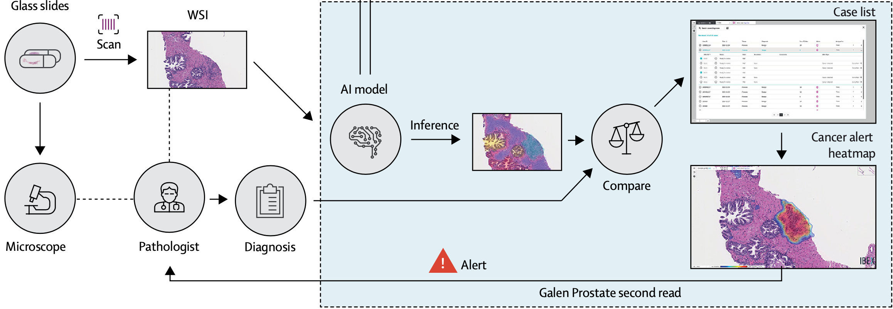
AP site verification example
Commercial AI model for diagnosis of prostate needle biopsies
Site deployment as a routine second-read system
Model calibrated to site using 159 local case parts (additional training)
Pantanowitz L, Quiroga-Garza GM, Bien L, et al. An artificial intelligence algorithm for prostate cancer diagnosis in whole slide images of core needle biopsies: a blinded clinical validation and deployment study. Lancet Digit Health. 2020;2(8):e407-e416. doi:10.1016/s2589-7500(20)30159-x

Slide 53
Verification data
Power calculation to define required sample size for verification
100 consecutive cases, 379 parts (usually 3 parts/case), and 1627 slides
Gold standard was initial pathology report
  65 parts reviewed by 2 blinded GU pathologists for confirmation
Pantanowitz L, Quiroga-Garza GM, Bien L, et al. An artificial intelligence algorithm for prostate cancer diagnosis in whole slide images of core needle biopsies: a blinded clinical validation and deployment study. Lancet Digit Health. 2020;2(8):e407-e416. doi:10.1016/s2589-7500(20)30159-x

Slide 54
Performance metrics at site
Performance for benign vs cancer
  Cancer in data set 20% 37%
  ROC AUC 0.997 0.991
  Sensitivity (recall) 99.6% 98.5%
  Specificity 90.1% 97.3%
  PPV (precision) 71.7% 95.5%
  NPV 99.9% 99.1%
Developer
benchmark
Site performance
Pantanowitz L, Quiroga-Garza GM, Bien L, et al. An artificial intelligence algorithm for prostate cancer diagnosis in whole slide images of core needle biopsies: a blinded clinical validation and deployment study. Lancet Digit Health. 2020;2(8):e407-e416. doi:10.1016/s2589-7500(20)30159-x

Slide 55
Performance monitoring
Goals
  Confirm and document adequate and stable model performance
  Identify performance/problems for reporting to the developer and FDA
Current options
  Periodic evaluation of discrimination and calibration using parallel analyses
Needs and open questions*
  Methods to ensure consistent high-quality histology
  Methods to detect relevant shifts and drifts in the data rapidly
  Practical methods to evaluate model performance without duplicate work (ie, PT)
  Methods to remediate loss of discrimination or calibration
  A regulatory environment promoting best practices in performance monitoring
*Adapted from Ashmore R, Calinescu R, Paterson C. Assuring the machine learning lifecycle: Desiderata, methods, and challenges. ACM Comput Surv. 2021;54(5):1-39. doi:10.1145/3453444

Slide 56

Framework for ML implementation in pathology
Define the clinical goal and deployment setting
Select ML tool(s) that meet the goal
Compare local data with ML training and testing data
  Statistical comparison to identify data mismatch
Conduct a retrospective performance evaluation
  Comparison to performance claims from package insert
Conduct a bias assessment
  Identify relevant subgroups and verify subgroup performance with adequate numbers
Conduct a prospective performance evaluation
  Realistic case mix with ML tool running in background or parallel, confirm performance
Deploy the ML tool and monitor performance over time
Work in progress icon created by Freepik – Flaticon
Notes:
A regulatory environment for AI in general that defines acceptable methods and results (like CLIA for labs) is lacking so far.

Slide 57

Key points
Machine learning is likely to be used widely in healthcare
There are many machine learning algorithms with different features, but there are important similarities in their training and deployment
Machine learning models can be opaque (“black box”) or transparent
ML models are sensitive to the details of training and deployment data and will not perform well if trained or deployed incorrectly
Bias is a significant risk and ML performance verification is necessary
Methods for verifying ML performance are in development and have analogies to and differences from verifying laboratory test performance
Key icon created by juicy_fish – Flaticon
Notes:
#3, be careful how you interpret what they’re doing, be skeptical about methods that “explain” AI decisions except for decision trees.

Slide 58

Readings
Harrison JH, Gilbertson JR, Hanna MG, et al. Introduction to artificial intelligence and machine learning for pathology. Arch Pathol Lab Med. 2021;145(10):1228-1254. doi:10.5858/arpa.2020-0541-cp
James CA, Wachter RM, Woolliscroft JO. Preparing clinicians for a clinical world influenced by artificial intelligence. JAMA. Published online March 21, 2022. doi:10.1001/jama.2022.3580
Scott I, Carter S, Coiera E. Clinician checklist for assessing suitability of machine learning applications in healthcare. BMJ Health Care Inform. 2021;28(1):e100251. doi:10.1136/bmjhci-2020-100251
Book icon created by Good Ware – Flaticon

Slide 59

Permitted uses
© 2024 James H. Harrison, Jr. except as noted below. The original material in this slide set is made available under a Creative Commons Attribution 4.0 (CC BY 4.0) International License. The contents may be used without restriction, modified, and redistributed if they are attributed and any changes are indicated. Some graphical elements are used with permission or according to their own licenses requiring attribution. Attribution links are provided on the slide of use or on the Permitted Uses slide (this slide). These elements may be used and included in modified and redistributed work consistent with the licenses specified at the linked sites, provided that the links are included in the redistributed material.
The cover image is a composite of two laboratory images from Pixabay available for use without attribution.
All figures from journals are open access with Creative Commons licenses available at the linked sources.

